Slide 1
12D: Quantum Fourier Transform

Slide 2
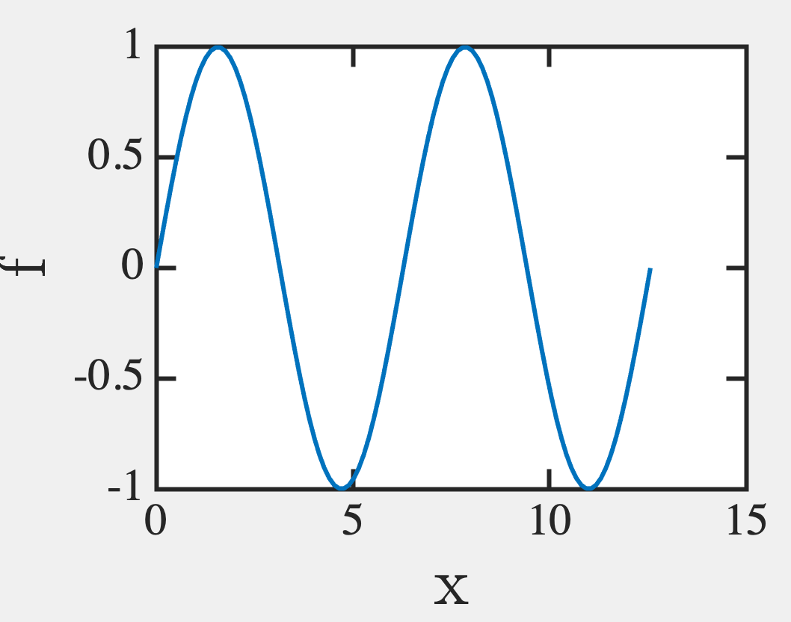
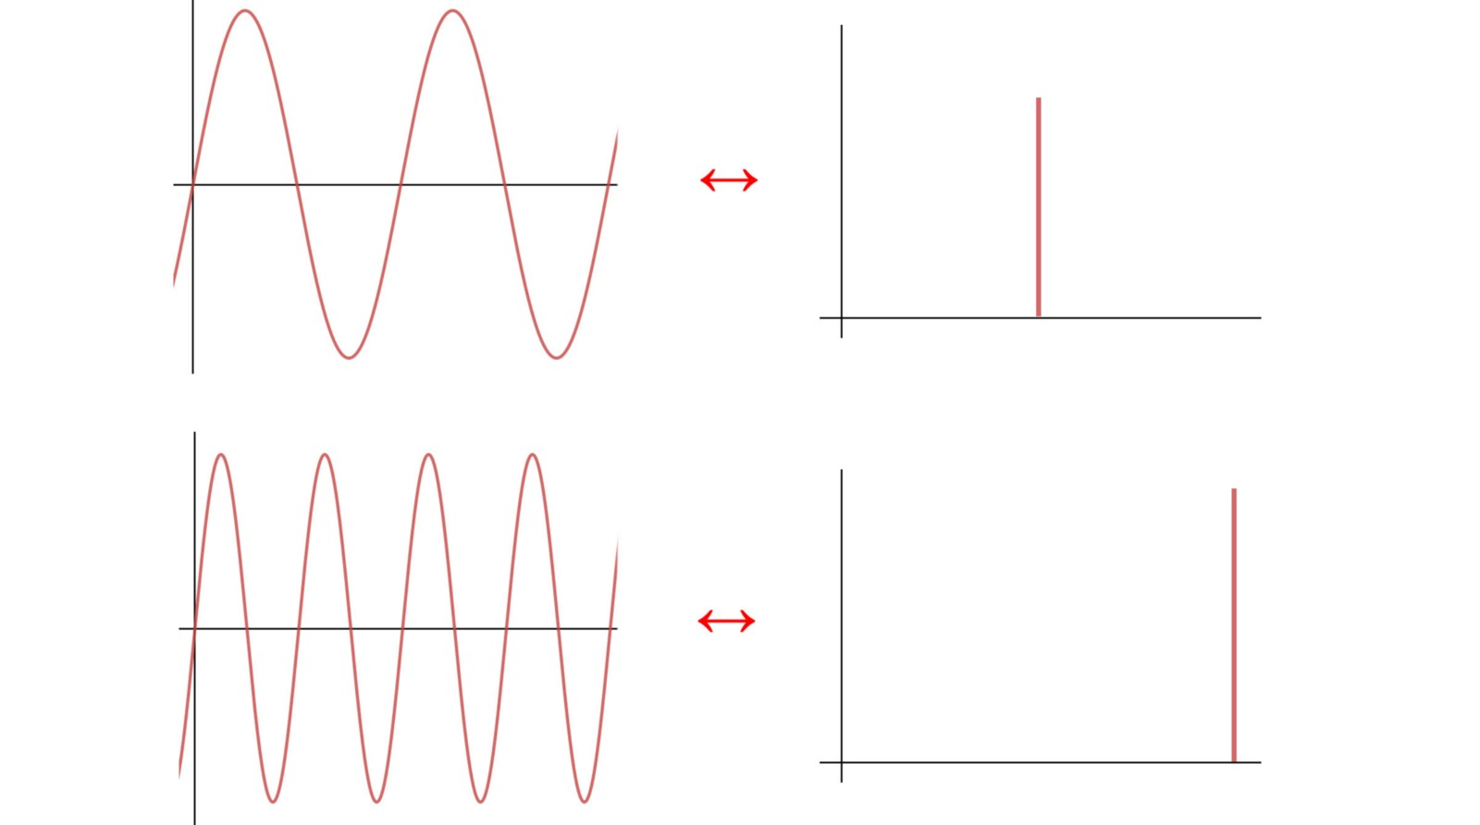
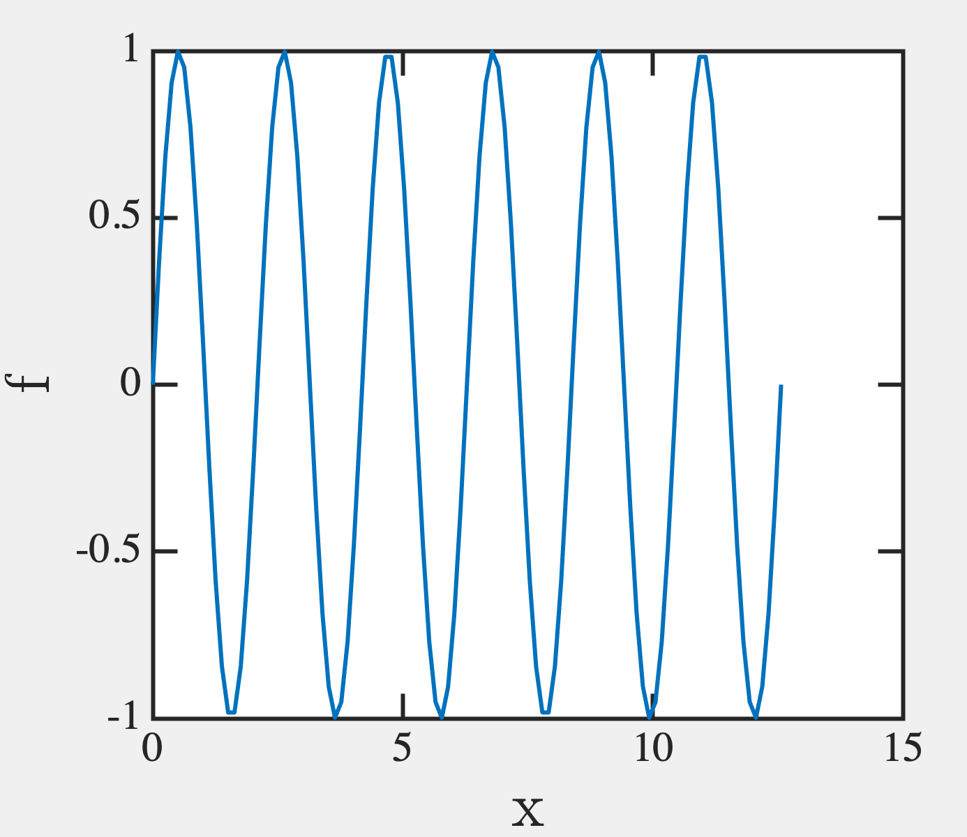
How to find period
Continuous Fourier Transform
∞
⌠
F(k) = f(x)e^{-ikx}dx/√2π
⌡
⁰
e.g.
Periodic Fn f(x) = e^{iαx}
→ F(k) = √2π δ(k-α)
∞
⌠
e^{ix(k-k0)}dx = 2πδ(k-k₀)
using
⌡
⁰

Slide 3
Discrete Fourier Transform: period changes from 2π to M
n,k must be integers
^{M-1}
F_{k} = (1/√M) Σf_{n}e^{-2πikn/M}
^{n=0}
e.g.
Periodic Fn f_{n} = e^{in(2πα/M)}
Σe^{ix(k-k0)} = Mδ_{k-k0}
→ F_{k} = √M δ_{k-α}
using
^{x}
https://medium.com/@jonathan_hui/qc-quantum-fourier-transform-45436f90a43

Slide 4
Discrete FT
Jonathan Hui
Period r
Period M/r
As r increases (fewer beats within x), M/r decreases ➔ more harmonics
Extreme case – 1 blip in x ie aperiodic (period M)
Fourier period 1 (all frequencies)

Slide 5
Discrete FT
Jonathan Hui
Period r
Period M/r
As r increases (fewer beats within x), M/r decreases ➔ more harmonics
Extreme case – 1 blip in x ie aperiodic (period M)
Fourier period 1 (all frequencies)

Slide 6
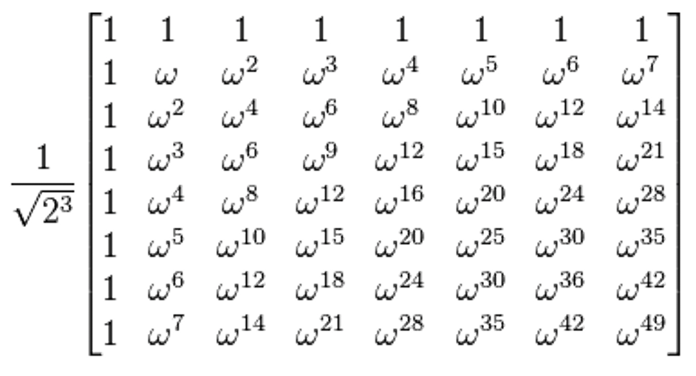
How to find period
^{M-1}
^{M-1}
y_{k} = (1/√M) Σx_{n}e^{-ikn2π/M} = Σx_{n}ω^{kn}, where ω = e^{-i2π/M}
Say M=8
k=0, y₀= x₀+x₁+x₂+x₃+x₄+x₅+x₆+x₇
k=1, y₁= x₀+x₁ω+x₂ω²+x₃ω³+x₄ω⁴+x₅ω⁵+x₆ω⁶+x₇ω⁷
…….
^{n=0}
^{n=0}
y₀
x₀
y₁
x₁
y₂
=
x₂
…….
…….
y₇
x₇

Slide 7
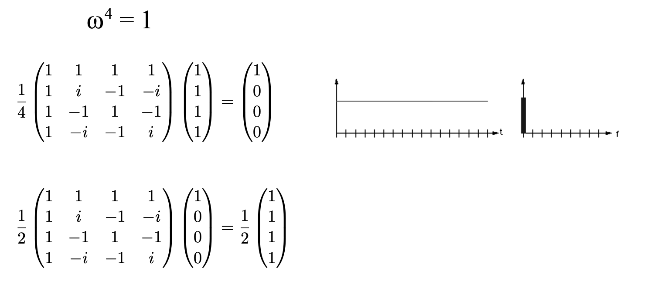
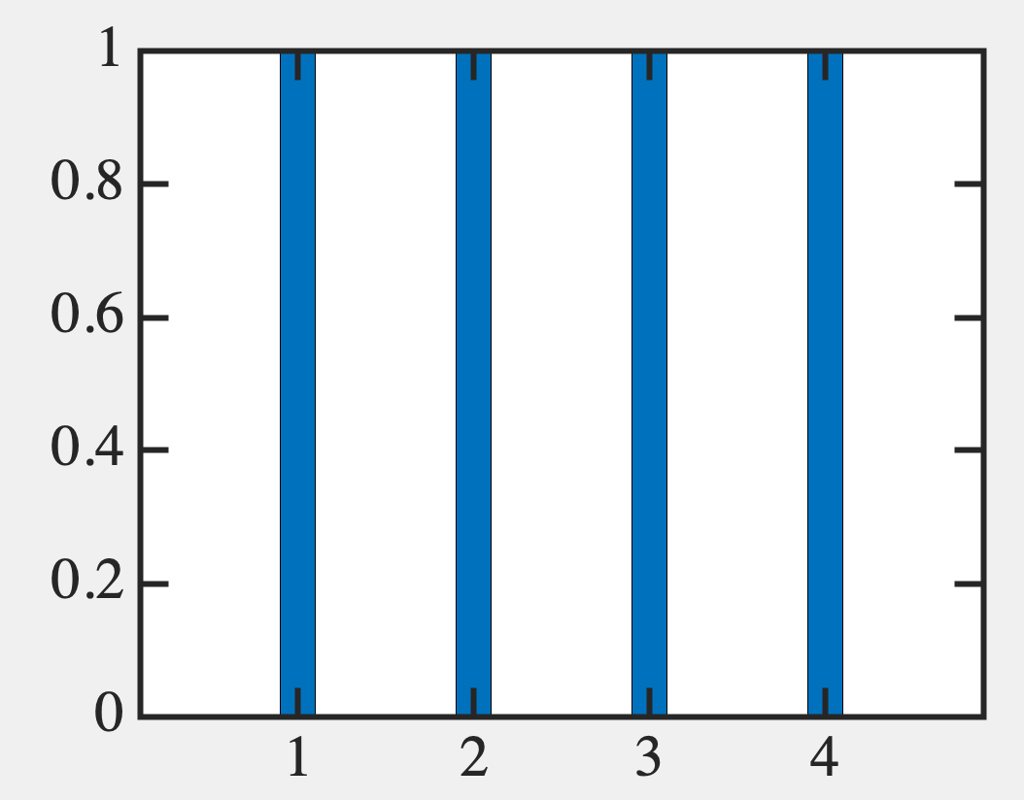
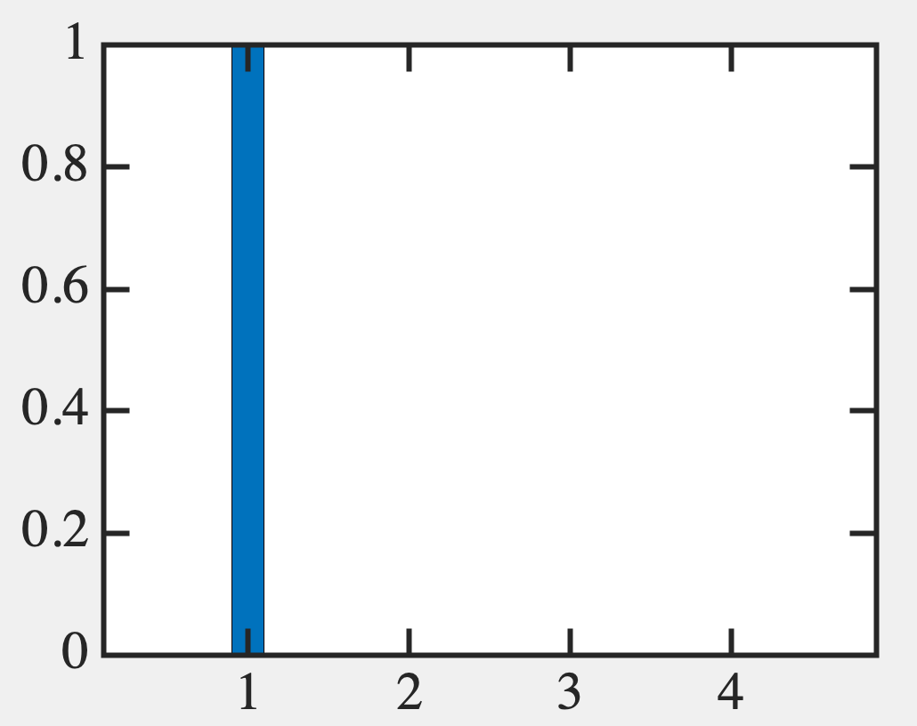
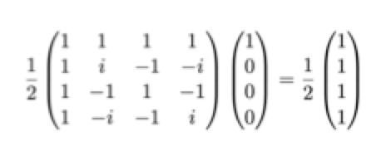
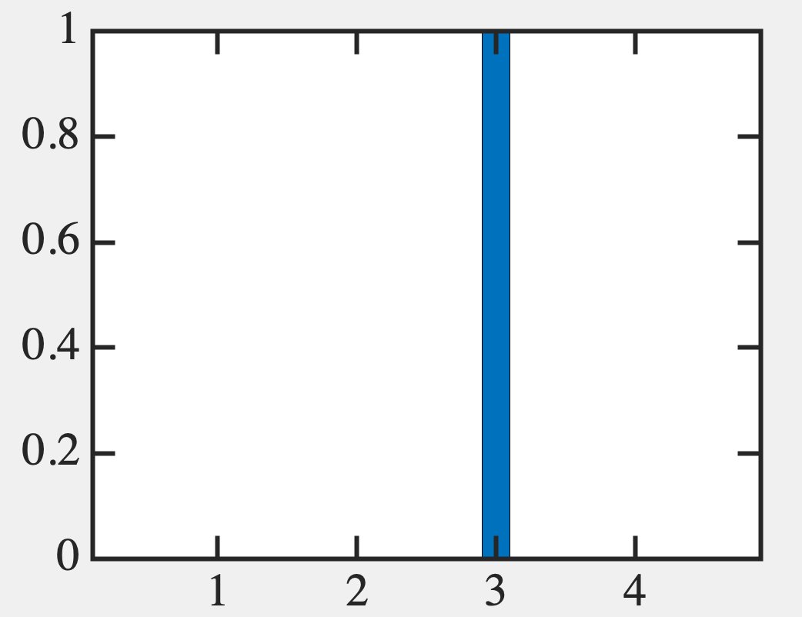
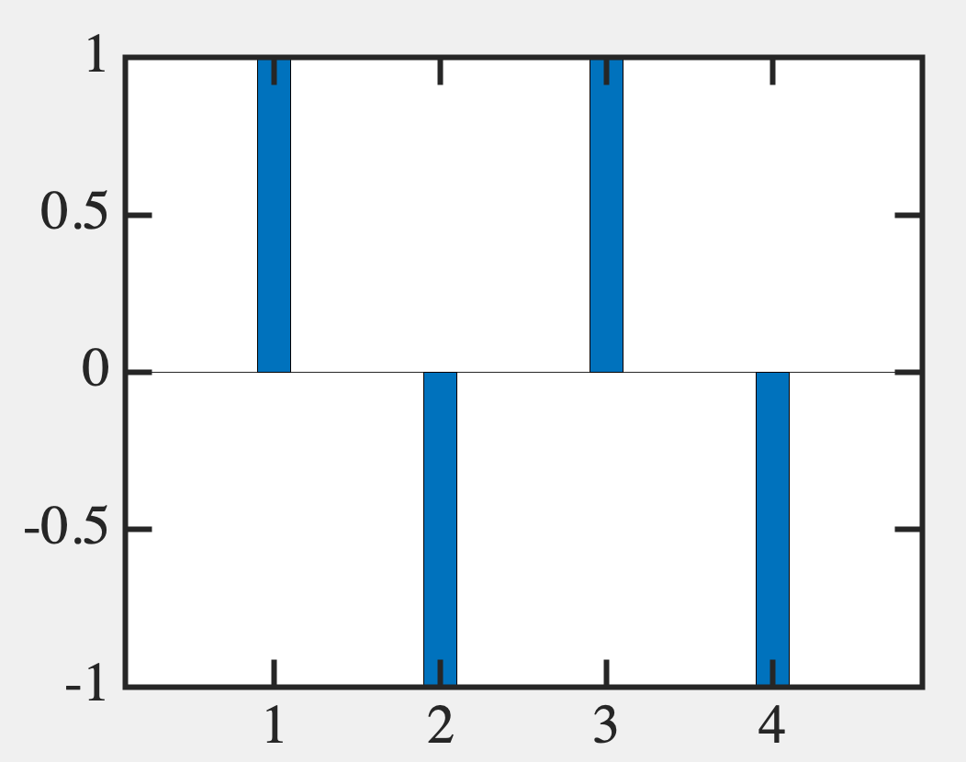
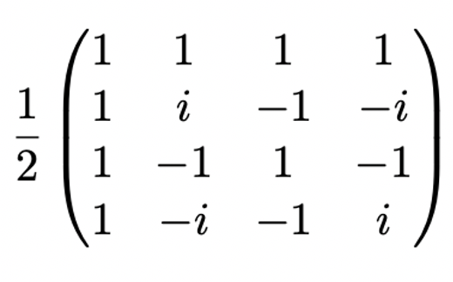
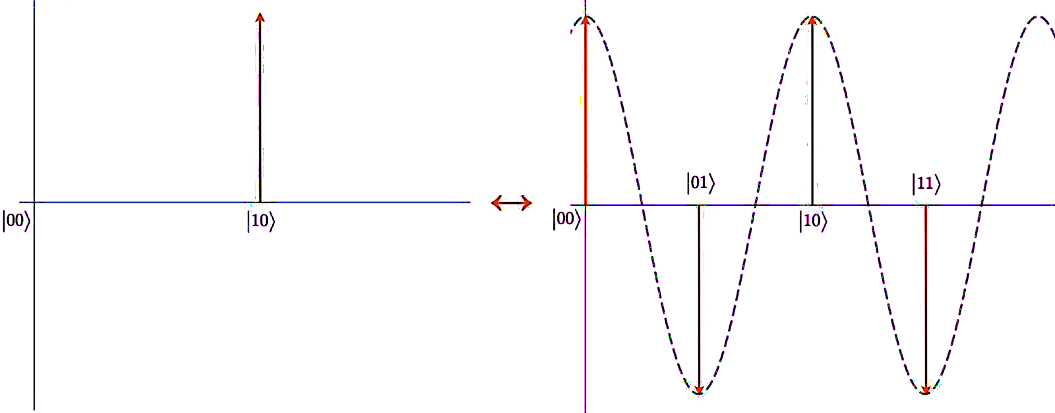
Jonathan Hui
Does this capture the period?
Period 1 (every blip)
Period 4
(1 blip in total stack of 4)
Period 4
Period 1
Shifted Period 4
Period 1 in magnitude
0
1
0
-1
1
1
0
-1

Slide 8
What gates will create this?
ω⁸ = 1, where ω = exp[2πi/8]
For N = 2, ω = exp[πi] = -1 → Hadamard Gate
1
1
H =
/√2
1
-1

Slide 9
QFT circuit
Hadamard Gates

Slide 10
QFT circuit
R_{k}
Phase Shift Gates

