Slide 1
12E: Proof that this circuit works

Slide 2
Notation

Slide 3
What are the Fouriers operating on?
They operate on 2^{N} dimensional vectors
which are Kronecker products of 2x1 vectors

Slide 4
Generalizing…

Slide 5
Fourier Transform

Slide 6
Fourier Transform

Slide 7
Fourier Transform

Slide 8
How to execute a QFT

Slide 9
QFT circuit

Slide 10
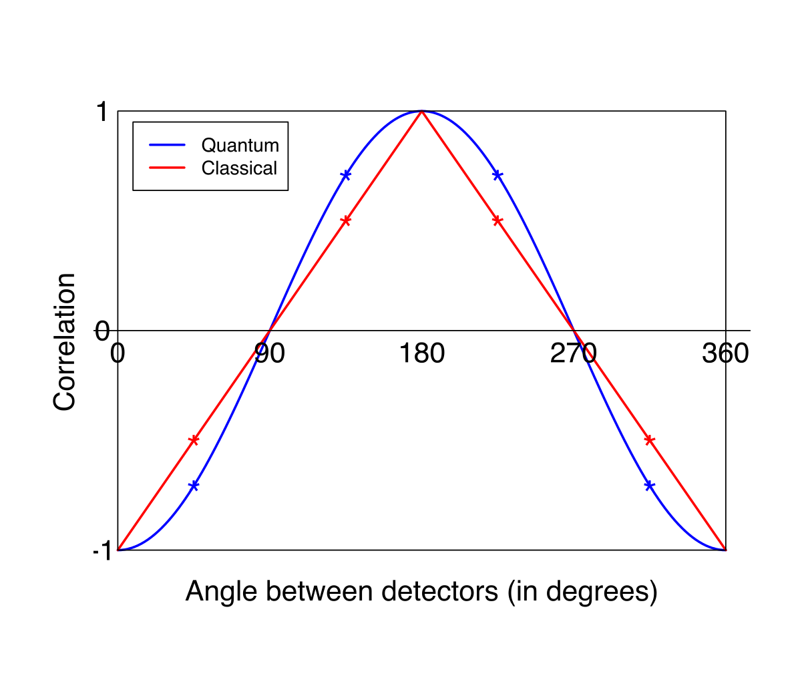
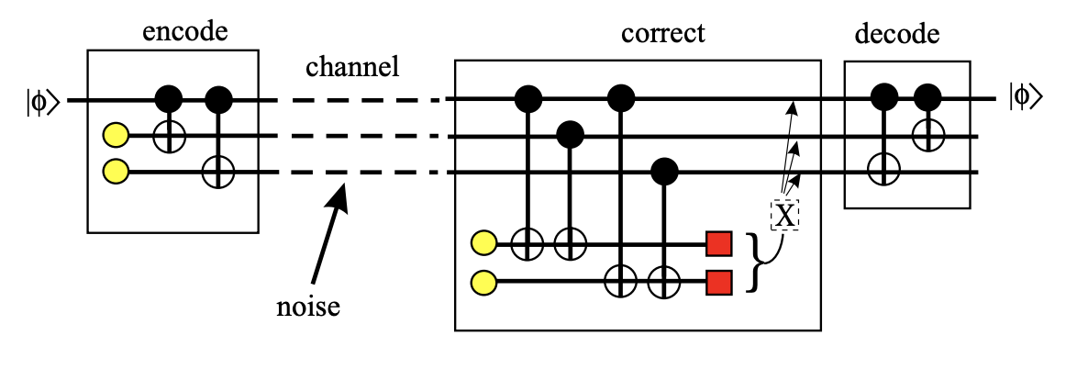
Fundamentals of Computing
Lec 13
Quantum Entanglement and Errors
Bell’s Inequality Error Correction

Slide 11
Fundamentals of Computing
Lec 13
Quantum Entanglement and Errors
Bell’s Inequality Error Correction

