Slide 1
Fundamentals of Computing
Lec 13
Quantum Error Correction
And Entanglement

Slide 2
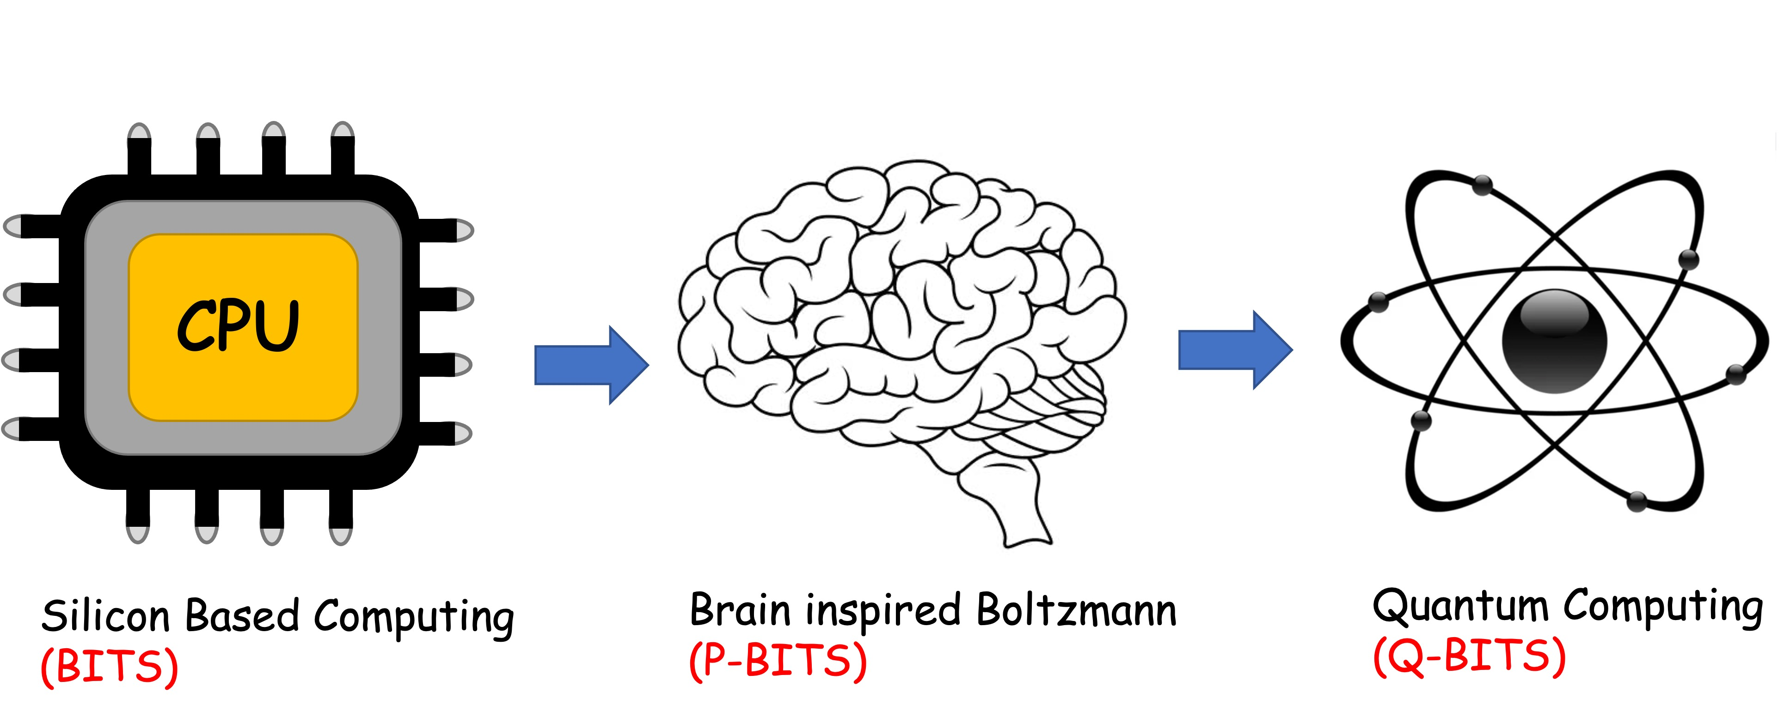
Overall structure of this course
Analog Computing in Carbo
How we train (Supervision)
Physics of Neurons (Boltzmann)
How we learn (time sampling)
Optimizing and Classifying
Transition Theory & Inferencing
Quantum Computing in Magneto
Quantum Spins and Hardware
Quantum Physics
Quantum Gates and Hardware
Quantum Entanglement
Quantum Gates and Factorization
Digital Computing in Silico
How we compute (algorithms)
How we add (Gates)
How we add quickly (CMOS)
How we fix errors
Thermodynamics of Computing

Slide 4
Quantum states are vectors
Operations are matrices
1
0
0
0
00
00
0
1
0
0
01
01
=
0
0
0
1
10
11
0
0
1
0
11
10
For any operation (e.g. R_{k},
QFT), need to check what
the states are and what
the operator is

Slide 5
The operators are unitary
Any unitary operator =
exponential of an
anti-Hermitian matrix

Slide 6
Steady-state

Slide 7
Quantum Statistical Mechanics
Replace vector with matrix
Field with Kronecker
Solve as before:
Boltzmann:
SCF/QMC:

Slide 8
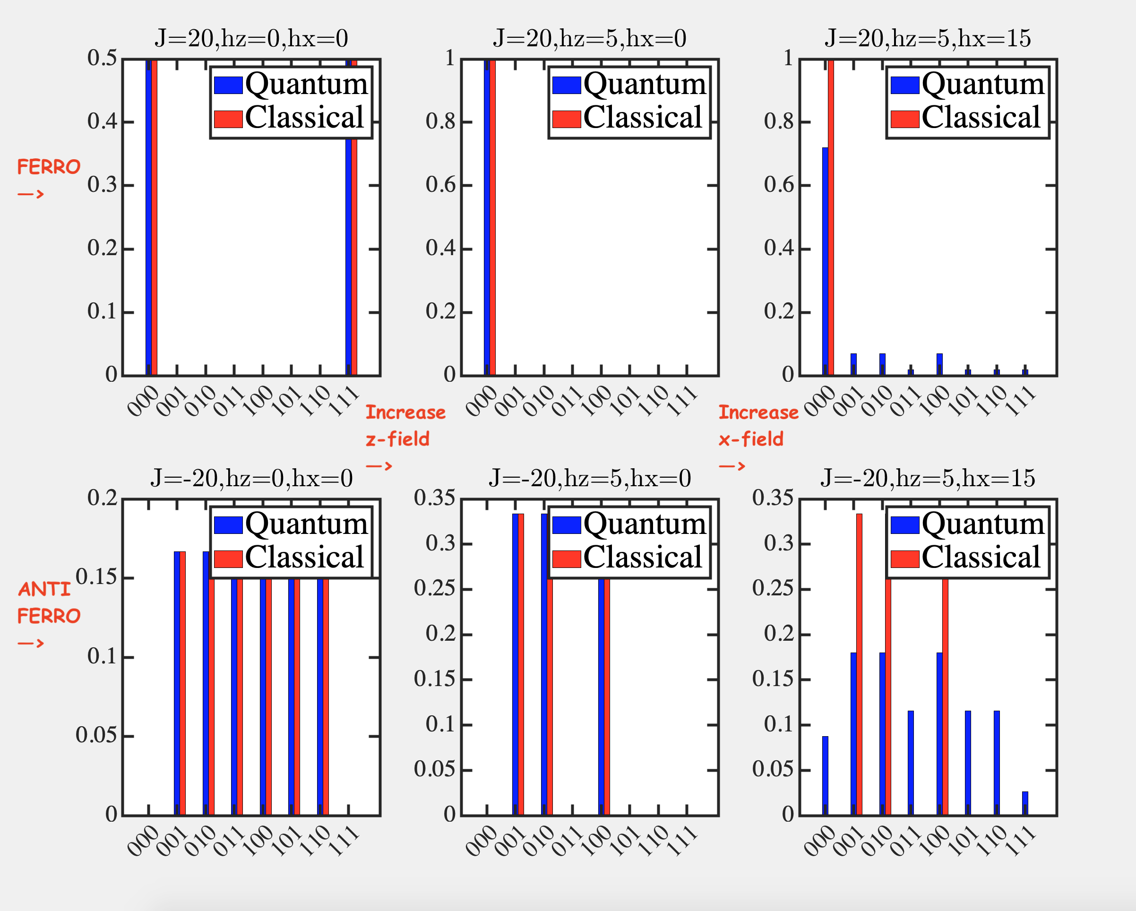
Quantum Statistical Mechanics

Slide 9
Importance of Linearity
Importance of Mixing

Slide 10
13A. How we copy and
error correct

Slide 11
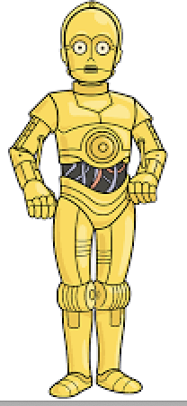
Suppose we can copy a given state

Slide 12
e.g. CNOT gate
A
B
Bout
A
A
0
0
0
0
A
1
0
1

Slide 13
Can we copy an unknown state?
No – it will not be linear !!!

Slide 14
Another way to state this

Slide 15
No Cloning Theorem
Not arbitrary and certainly not an unknown state !!

Slide 16
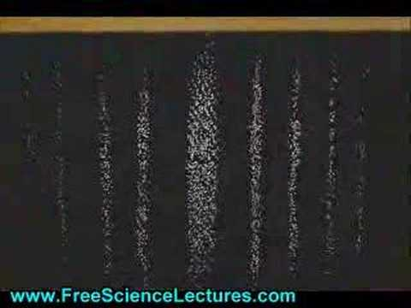
Makes sense!!! Only way the coeffs express themselves is through measurements, collapse, reprepare with identical
initial conditions, and remeasure

Slide 17
So how can we error correct?
110c1ba
Classical bits are easy to measure and repeat
Quantum bits can be entangled

Slide 18
Error Detection

Slide 19
Error Detection
Measurement along z-axis (‘classical’) does not help

Slide 20
Error Detection
Choose another axis
But again, only way we know this is through repeated
measurements

Slide 21
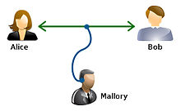
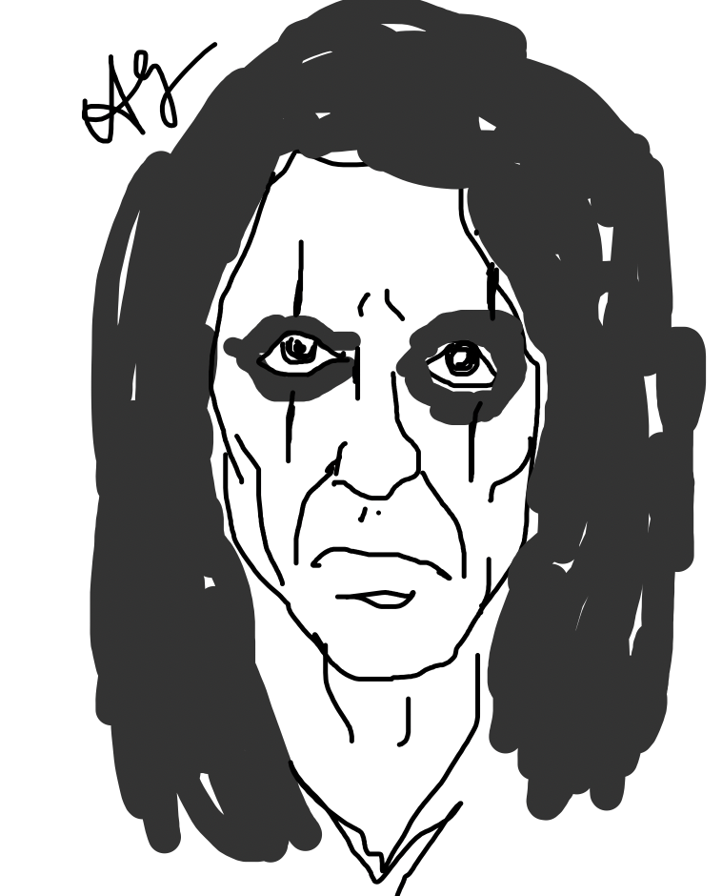
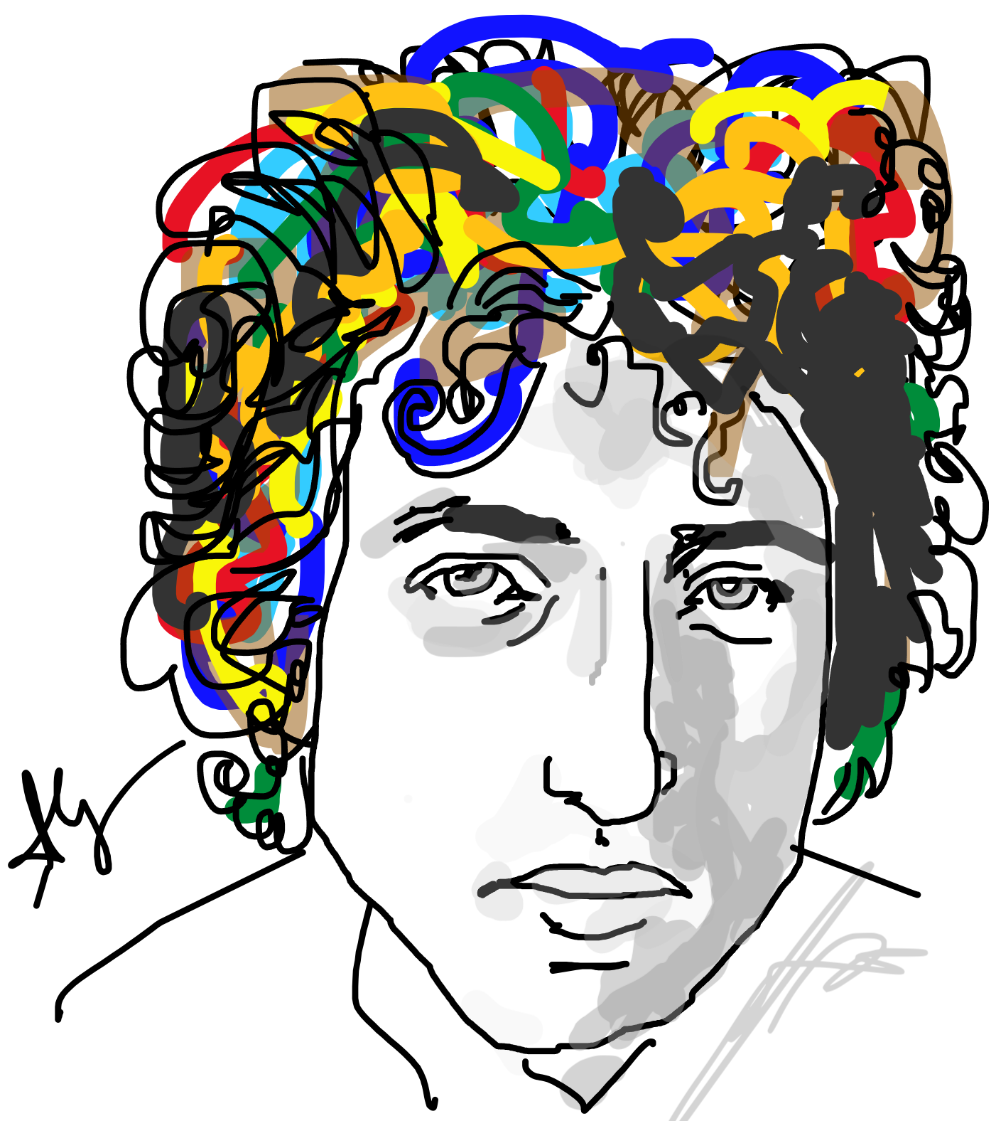
The saga of Alice and Bob

Slide 22
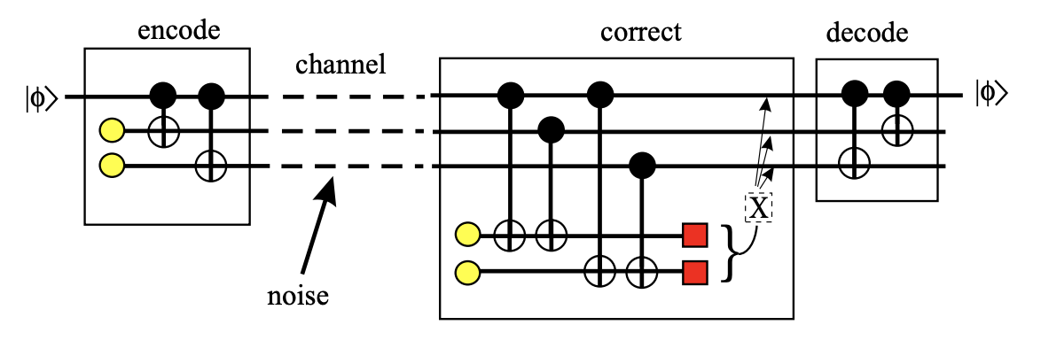
Error Correction: Alice does 2 CNOTs

Slide 23
Error corrupts qubits

Slide 24
Bob adds two ancilla bits, does CNOTs

Slide 25
Bob measures his ancillae & corrects

Slide 26
Bob’s error

Slide 27
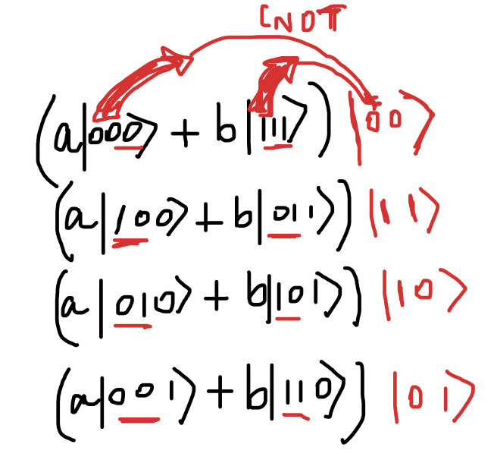
How could we measure ancilla without
Collapsing data bits?
Because they are factorized, ie,
not entangled.
In other words, a single set (not a
superposition) of Kronecker products

