Slide 1
13B. Maths of mixing states

Slide 2
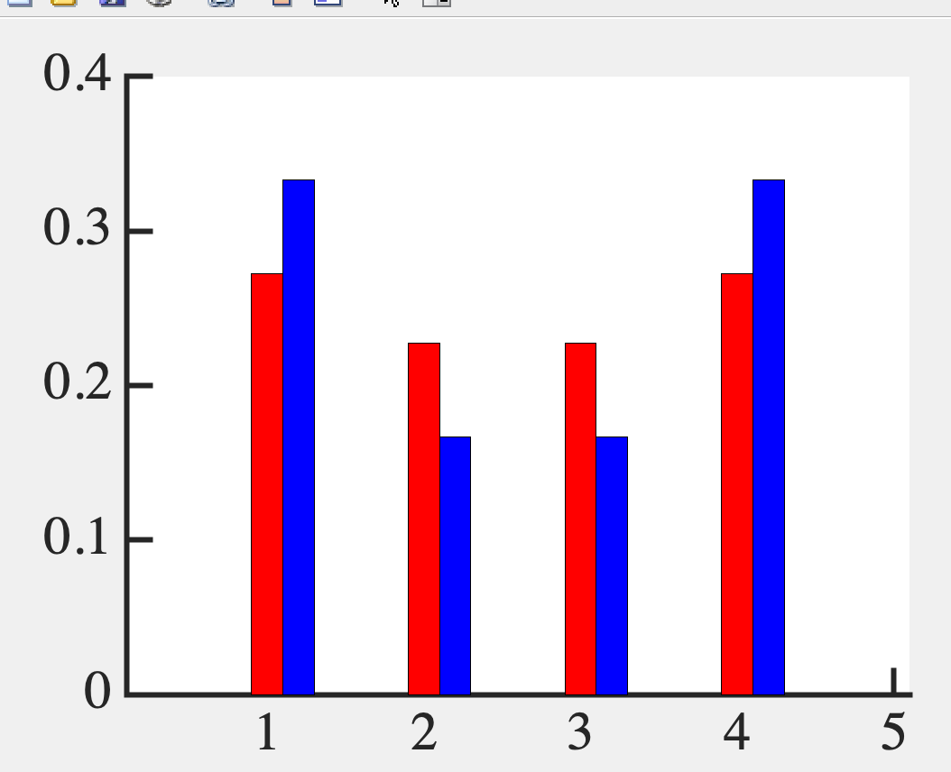
Average of a mixed state
How can we generalize?

Slide 3
Recall Bra-Kets
c₁
c₂
..
..
c_{n}
⎲
Ψ = c_{n}ψ_{n} =
⎳
_{n}
1
0
0
0
..
..
0
1
..
..
0
0
..
..
1
|ψ₁> =
|ψ₂> =
|ψ_{N}> =

Slide 4
“Bra-ket” (Bracket)
<Ψ|Ψ> = |c₁|² + |c₂|² +...+ |c_{N}|²

Slide 5
Pure States
< ψ_{i}|ψ_{j}> = δ_{ij}
< ψ_{i}|ψ_{i}> = 1
i
0
0
0
|ψ_{i} > < ψ_{i}| =
0
..
..
0
0
1
..
0
0
..
..
0
i
⎲
|ψ_{n} > < ψ_{n}| = I
⎳
_{n}

Slide 6
Mixed state
Quantum + Thermodynamic mix
p₁
0
0
ρ =
0
..
..
0
0
p_{i}
..
0
0
..
..
p_{n}
⎲
p_{n} |Ψ_{n}> <Ψ_{n}| =
⎳
_{n}

Slide 7
Pure State
p_{n} = 0 or 1
ρ² = ρ
Pure State

Slide 8
Average of a mixed state
<A> =
⎲
p_{n} <Ψ_{n}|A|Ψ_{n}>
⎳
_{n}
⎲
⎲
p_{n} <Ψ_{n}|A|Ψ_{m}> <Ψ_{m}|Ψ_{n}>
= Tr(ρA)
=
⎳
⎳
_{m n}

