Slide 1
13C: Maths of entanglement

Slide 2
Polarized Light
A C
A B C
P(AB) = cos²(45⁰) = 1/2
P(AC) = 0
P(BC) = cos²(45⁰) = 1/2
P(AC) = P(AB).P(BC) = 1/4
Inserting a middle layer improved transmission!

Slide 3
EPR Paradox:
Pion decay → two entangled states in a
singlet (e and e+ with opposite spins)
|00> + |11> → Move far far away
Measure bit 1 → 0
Bit 2 must collapse to 0 instantly !!
(Nonlocality since light needs finite time)

Slide 4
Is entanglement real?
Could uncertainty accommodate
a hidden variable?
Is uncertainty just in knowledge
or fundamental ??

Slide 5
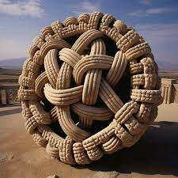
Maths of Entanglement
Entangled means you cannot separate (factorize)

Slide 6
Non-Entangled State (Factorizable)

Slide 7
One way to flip a state

Slide 8
How to turn a state over? Partial Density Matrix
Inverting a Kronecker product in a sense…

Slide 9
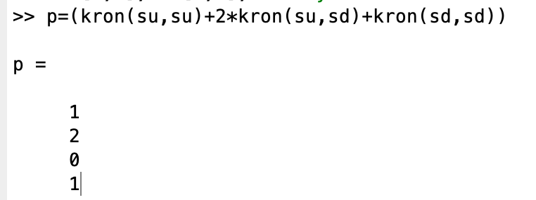
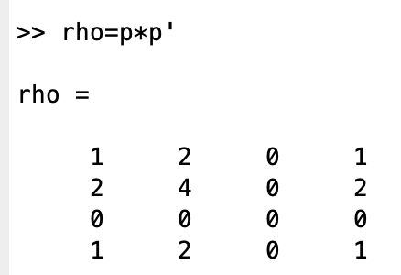
Entangled state

Slide 10
Partial Density Matrix

Slide 11
Partial Density Matrix

Slide 12
Unentangled (factorizable) state

Slide 13
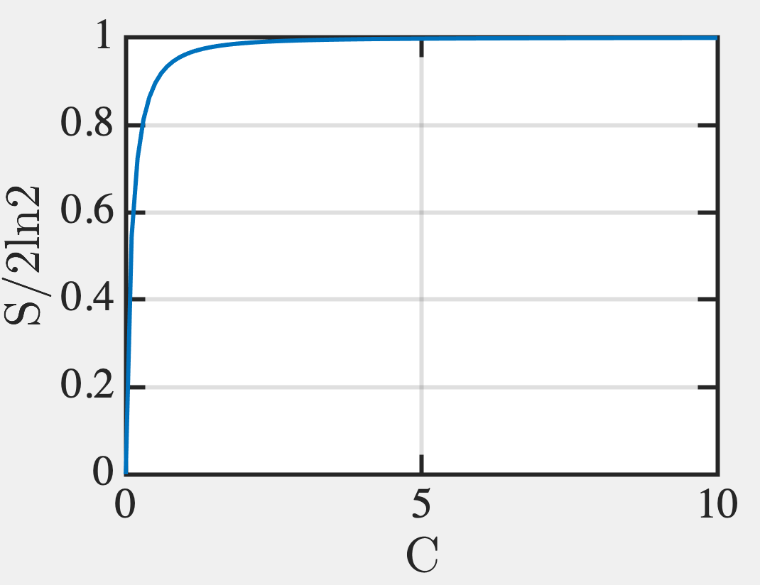
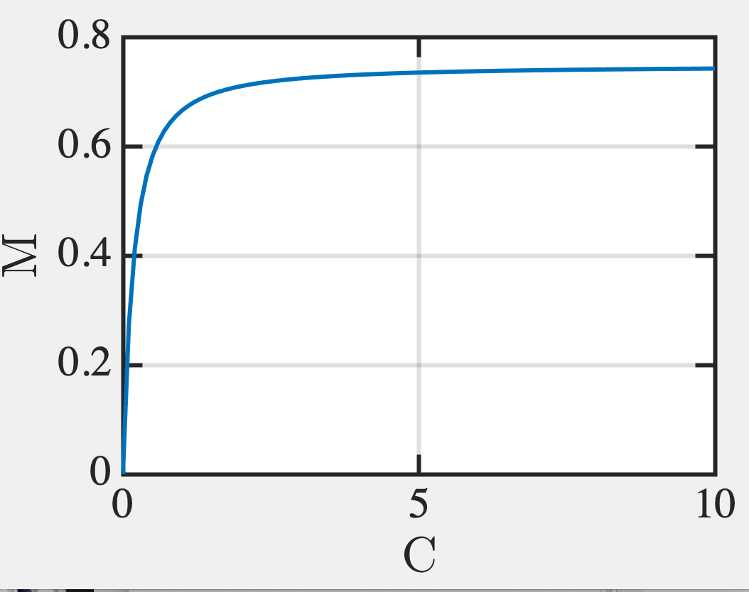
Von Neumann Entropy

Slide 14
For partial states

Slide 15
So Sign of Entanglement:
Partial Density Matrix must have
non-zero determinant
Matrices are not idempotent (not equal to their square)
Von Neumann entropy is non-zero

