Slide 1
13D: How to measure
entanglement

Slide 2
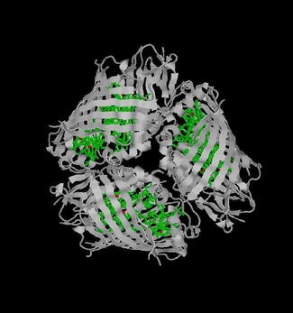
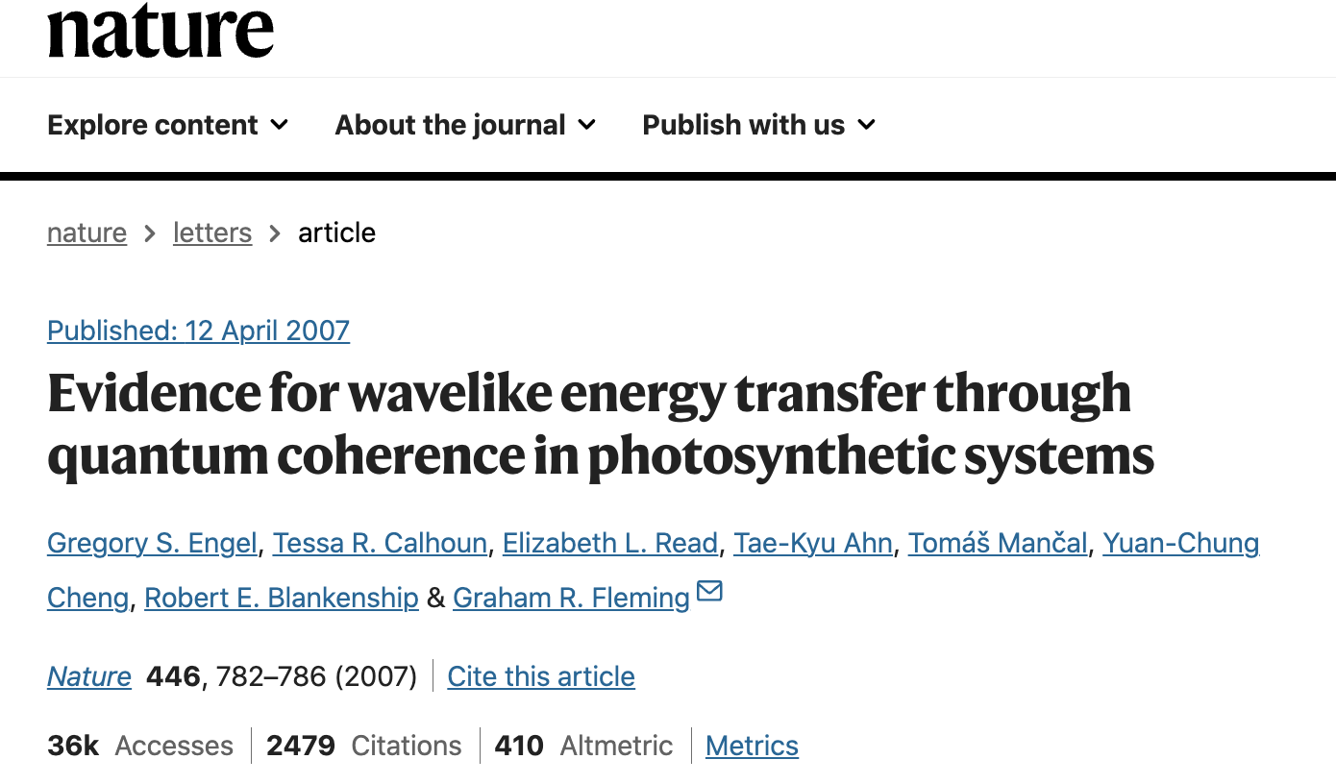
Photosynthesis needs Quantum Superposition
Energy efficiency ~ 100%

Slide 3
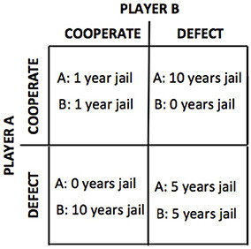
Prisoner’s Dilemma: A’s strategy?
If B defects, A should defect
(5 instead of 10 yr jail)
If B cooperates, A should defect
(0 instead of 1 yr jail)
SO A should Testify even if they are innocent !!! Expect 2.5 years in jail, but less than 5.5 if A does not defect.
This is the Nash Equilibrium in Game Theory, that dominates the Pareto optimal of (1,1) !!
(Where you can’t helping one person without hurting another)
Moreira, Catarina & Wichert, Andreas. (2016). Quantum Probabilistic
Models Revisited: The Case of Disjunction Effects in Cognition. Frontiers in Physics.
4. 10.3389/fphy.2016.00026.

Slide 4
Quantum Prisoner’s Dilemma
Can they share instructions without
consulting, so the probability of their
success is higher than classical physics?
Moreira, Catarina & Wichert, Andreas. (2016). Quantum Probabilistic Models Revisited: The Case of Disjunction Effects in Cognition. Frontiers in Physics. 4. 10.3389/fphy.2016.00026.

Slide 5
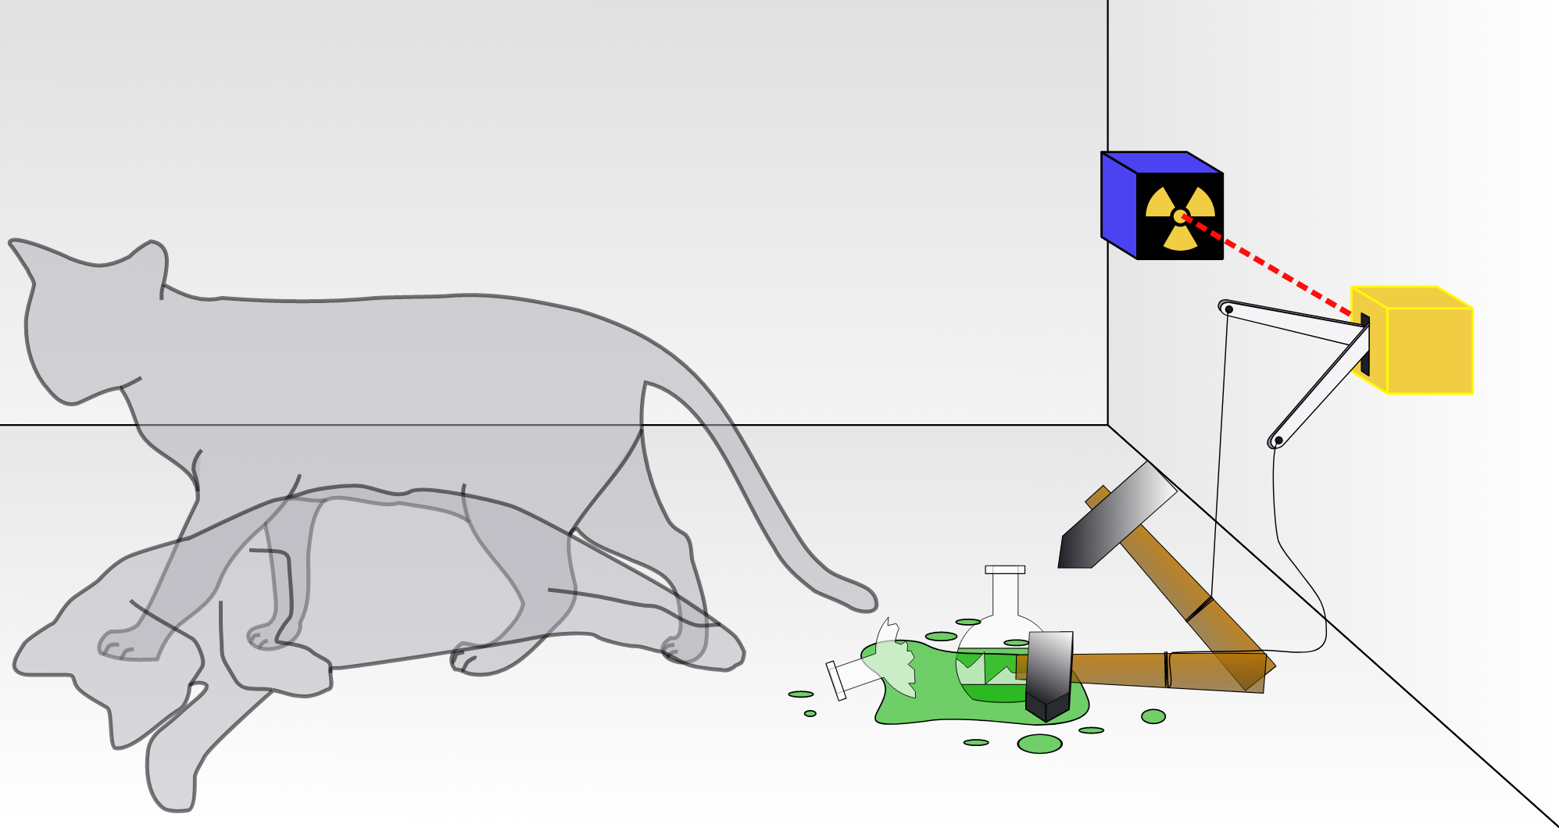
Bit Collapse upon measurement

Slide 6
Example: Alice and Bob share a photon qubit
Roulette: can your x and y satisfy:

Slide 7
Only freedom:
AB can report their measurement along any axes
Alice reports 0’s along the black ais (VH photons)
1’s along the red axis
Bob reports 0’s along the blue axis 1’s along the green axis
The ‘quantum’ reveals itself through statistics

Slide 8
Only freedom:
AB can report their measurement along any axes
00 → Joint probability cos²(π/8)
01 → Joint probability cos²(π/8)
10 → Joint probability cos²(π/8)
11 → Joint probability cos²(3π/8)
Prob of win = 1-cos²(3π/8) = cos²(π/8) ~ 85%
The ‘quantum’ reveals itself through statistics

Slide 9
Modified game: CHSH inequality

Slide 10
Classical CHSH Bound
±2 each time, so average ≤ 2
Realism (A, B value exist independent of being measured)
Locality (Alice and Bob don’t influence each other)
Quantum → Don’t have binary numbers, but 2x2 non-Commuting matrices with the same (but not simultaneous binary eigenvalues)

Slide 11
Just like 45 degree polarizers to mess
with probabilities.

Slide 12
QM violates it

Slide 13
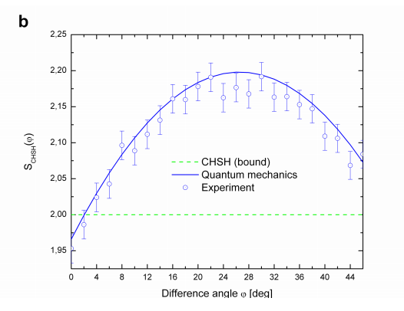

Slide 14
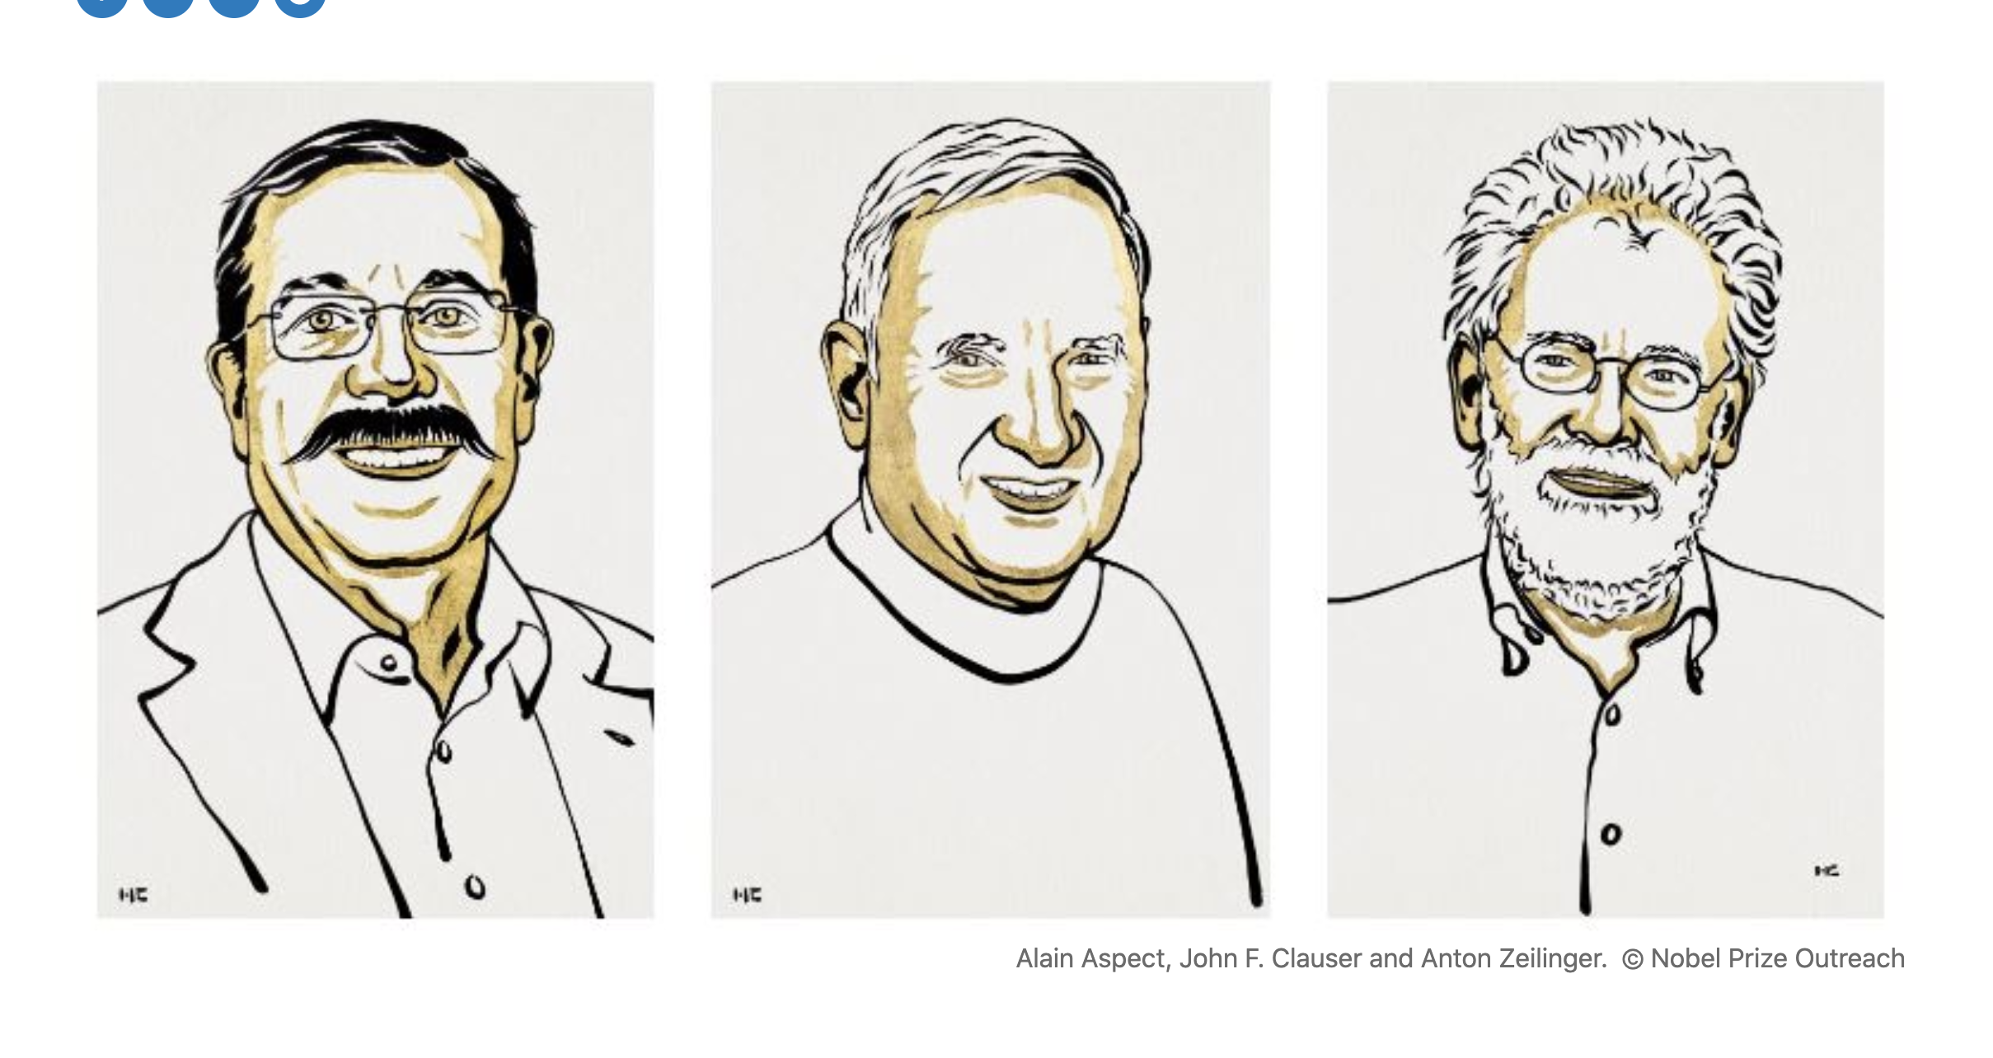

Slide 15
Entanglement is real
Electrons are in superposition
A classical measurement decouples
them by entangling with an apparatus.
Decoherence kills phase information

Slide 16
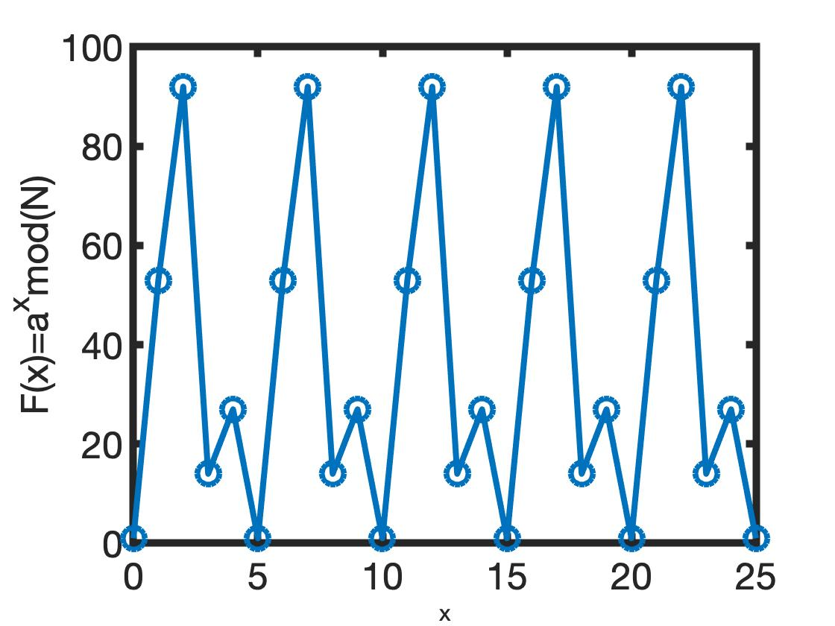
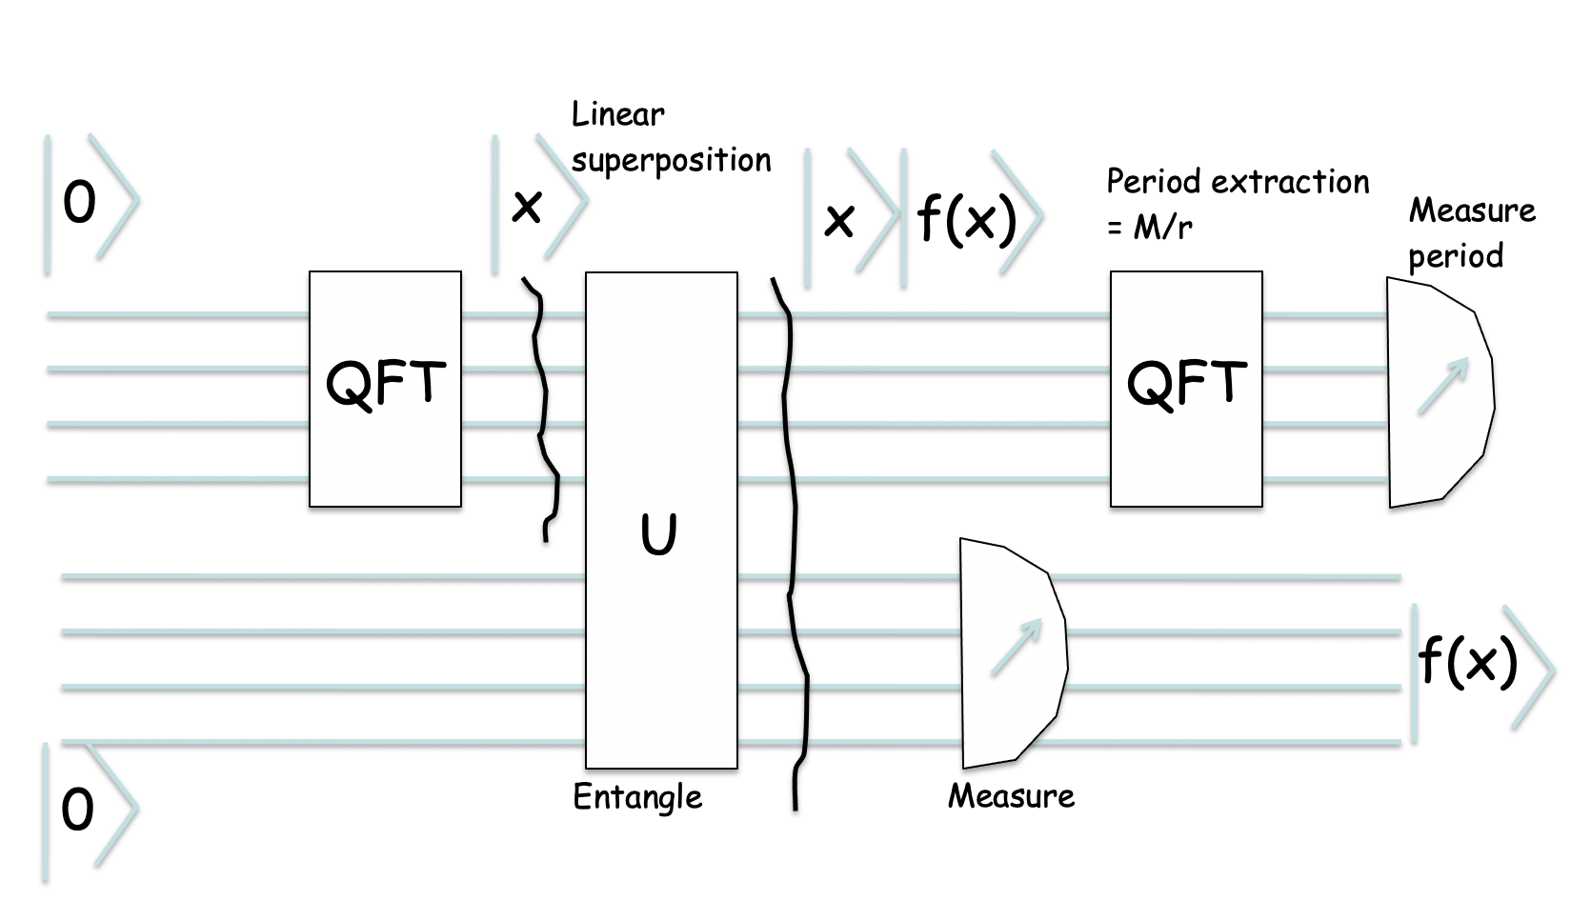
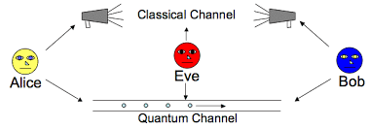
Next Lecture
How to use entanglement for quantum computing?
Grover Search
And Shor Factorizing (143)
Quantum Circuit
QC circuit
Quantum Cryptography
and Key distribution

