Slide 1
Fundamentals of Computing
Lec 14
Quantum Computing

Slide 2
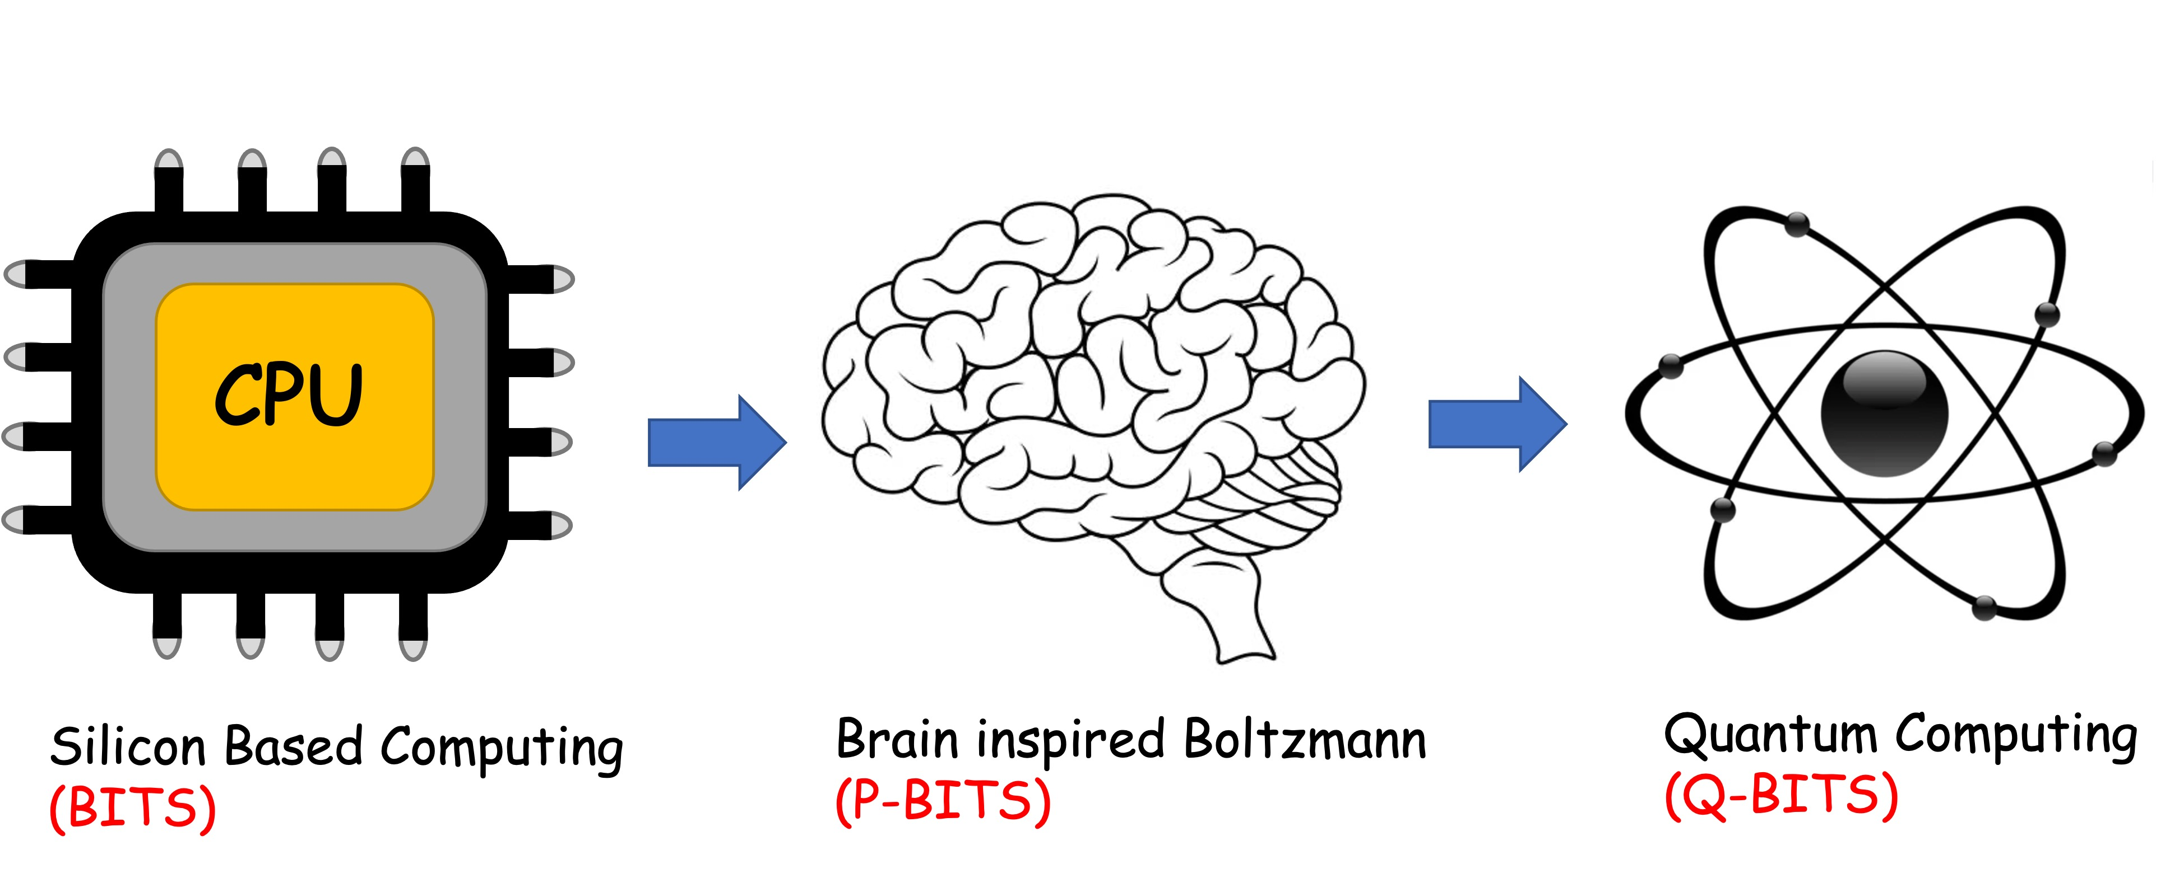
Overall structure of this course
Analog Computing in Carbo
How we train (Supervision)
Physics of Neurons (Boltzmann)
How we learn (time sampling)
Optimizing and Classifying
Transition Theory & Inferencing
Quantum Computing in Magneto
Quantum Spins and Hardware
Quantum Physics
Entanglement and Superposition
Quantum Computing
Digital Computing in Silico
How we compute (algorithms)
How we add (Gates)
How we add quickly (CMOS)
How we fix errors
Thermodynamics of Computing

Slide 4
Computing Speed-up
Simulating quantum processes on a classical computer??

Slide 5
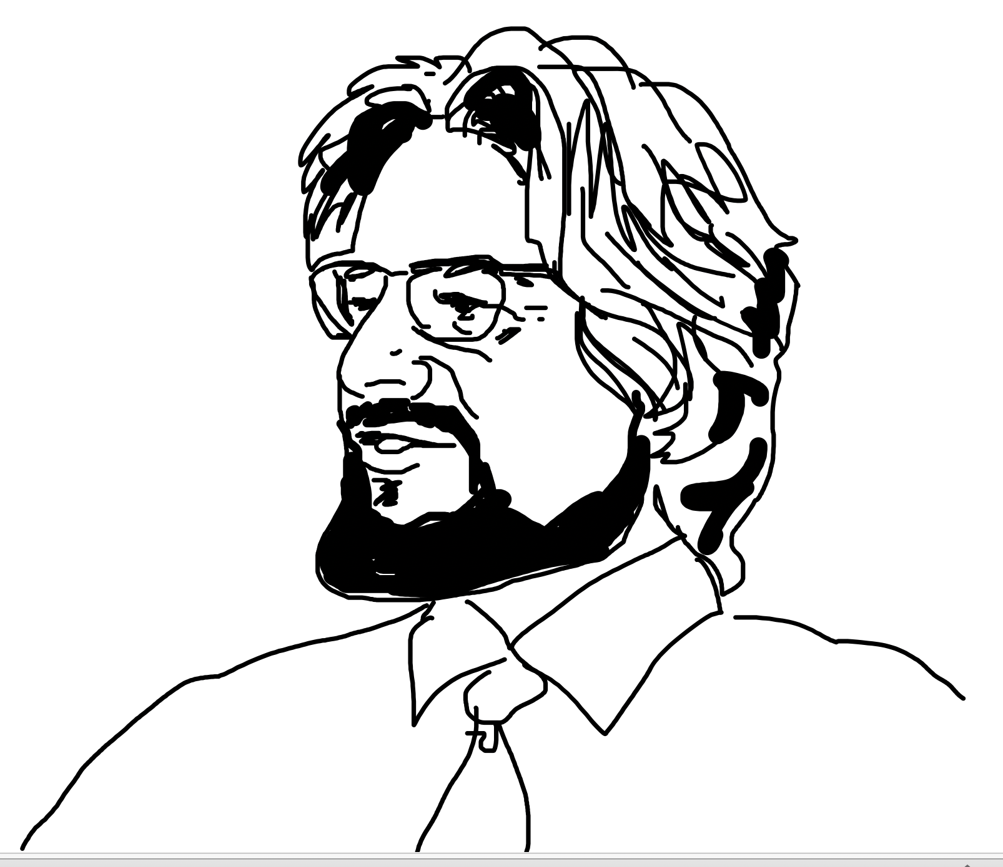
What we have seen so far
There is a fundamental, measurable difference between
classical variables that have an unknown but pre-assigned,
random value, vs quantum variables that do not possess
a value until you measure them.
The latter need non-commuting matrix representations
that manifest as entangled qubits (photons, spins)
John Stewart Bell

Slide 6
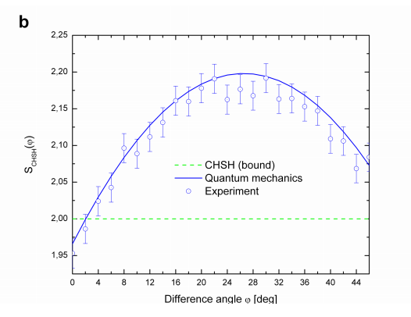
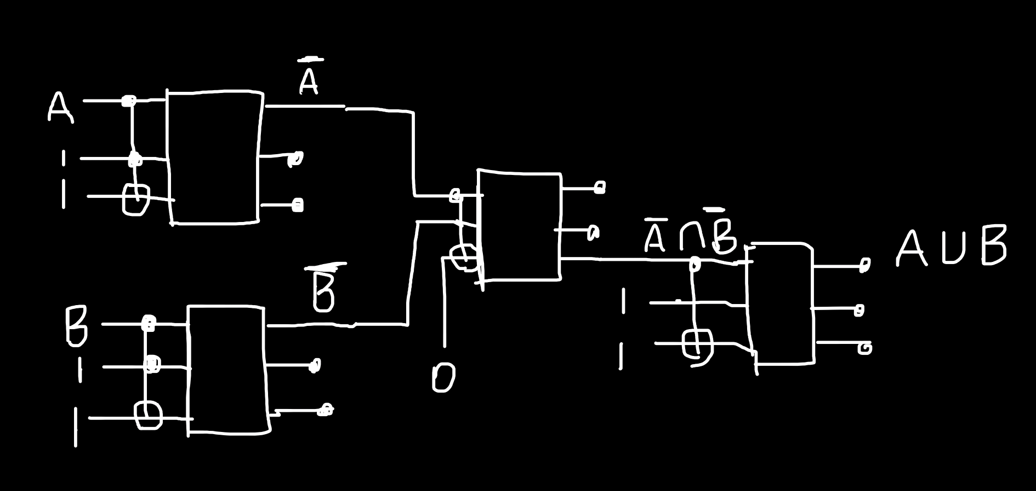
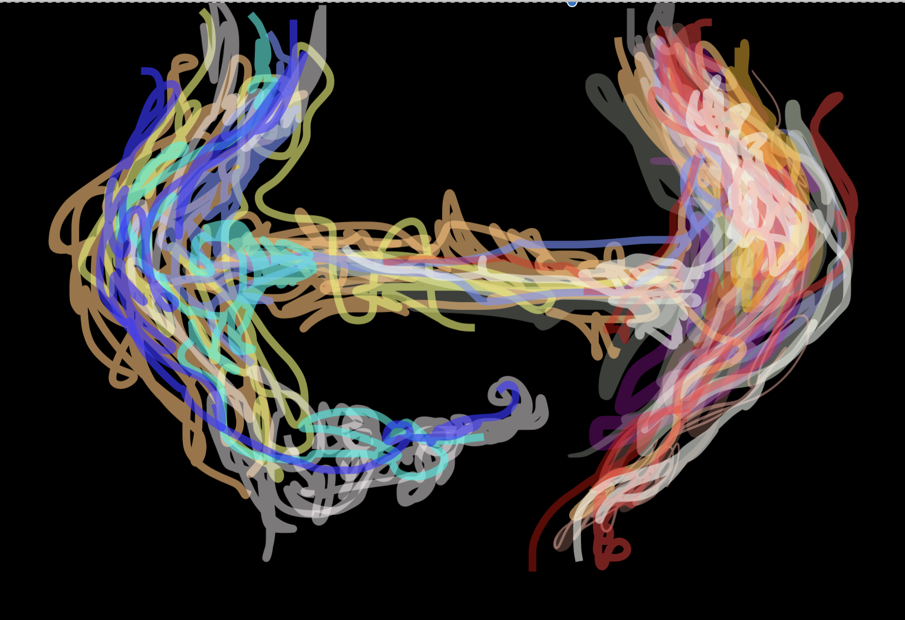
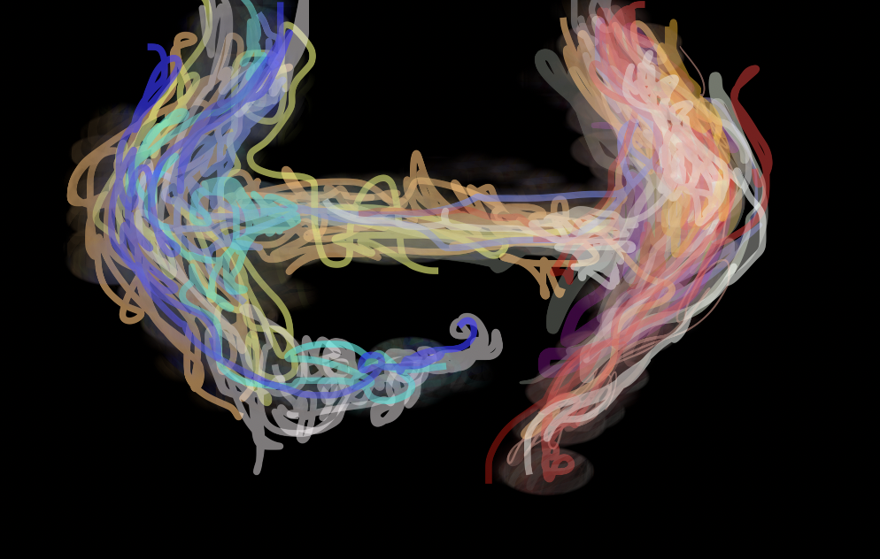
Quantum Circuits
Quantum Entanglement
Hadamard Gates
Phase Shift Gates
Toffoli-Fredkin Gates

Slide 7
14A. Quantum Key Distribution

Slide 8
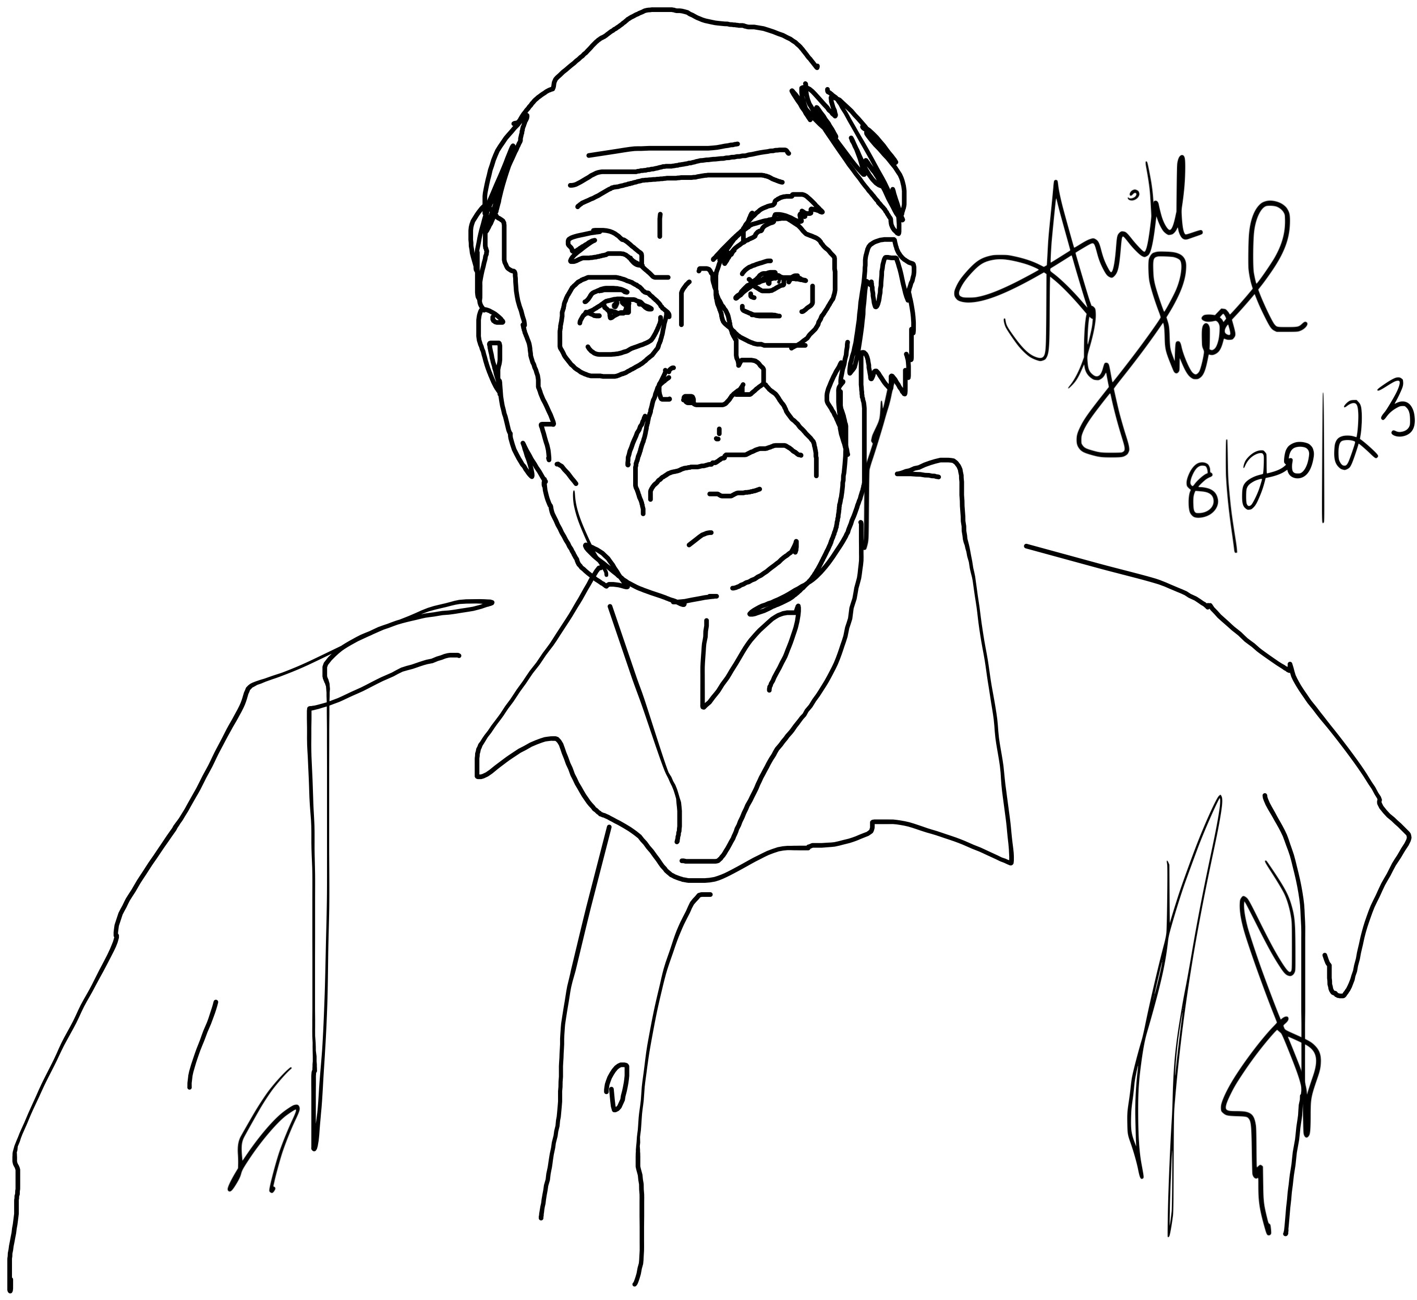
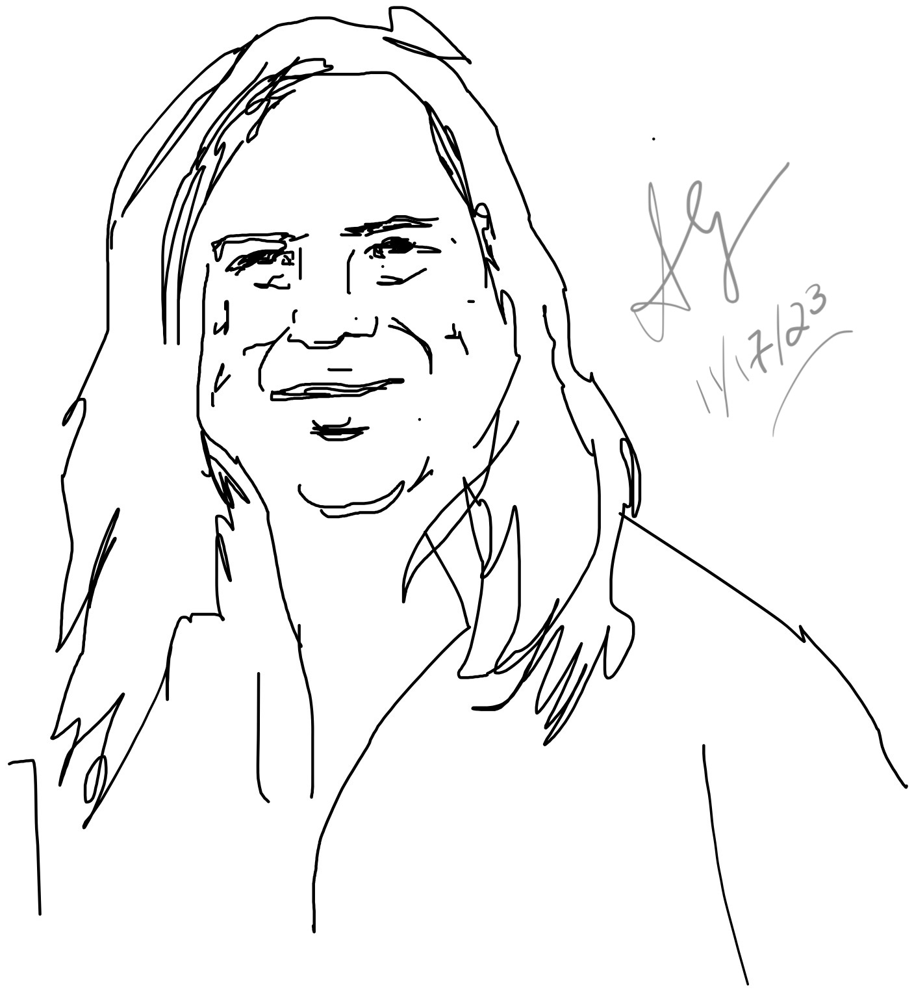
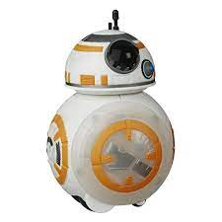
A well known key distribution approach
Charles Bennett
Gilles Brassard
4 protocol

Slide 9
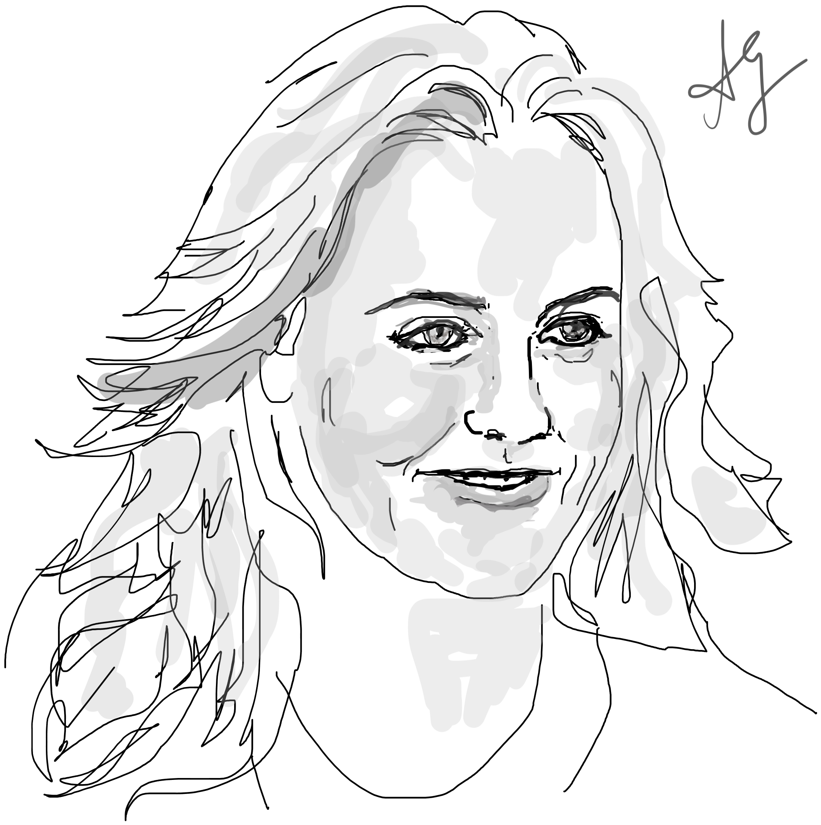
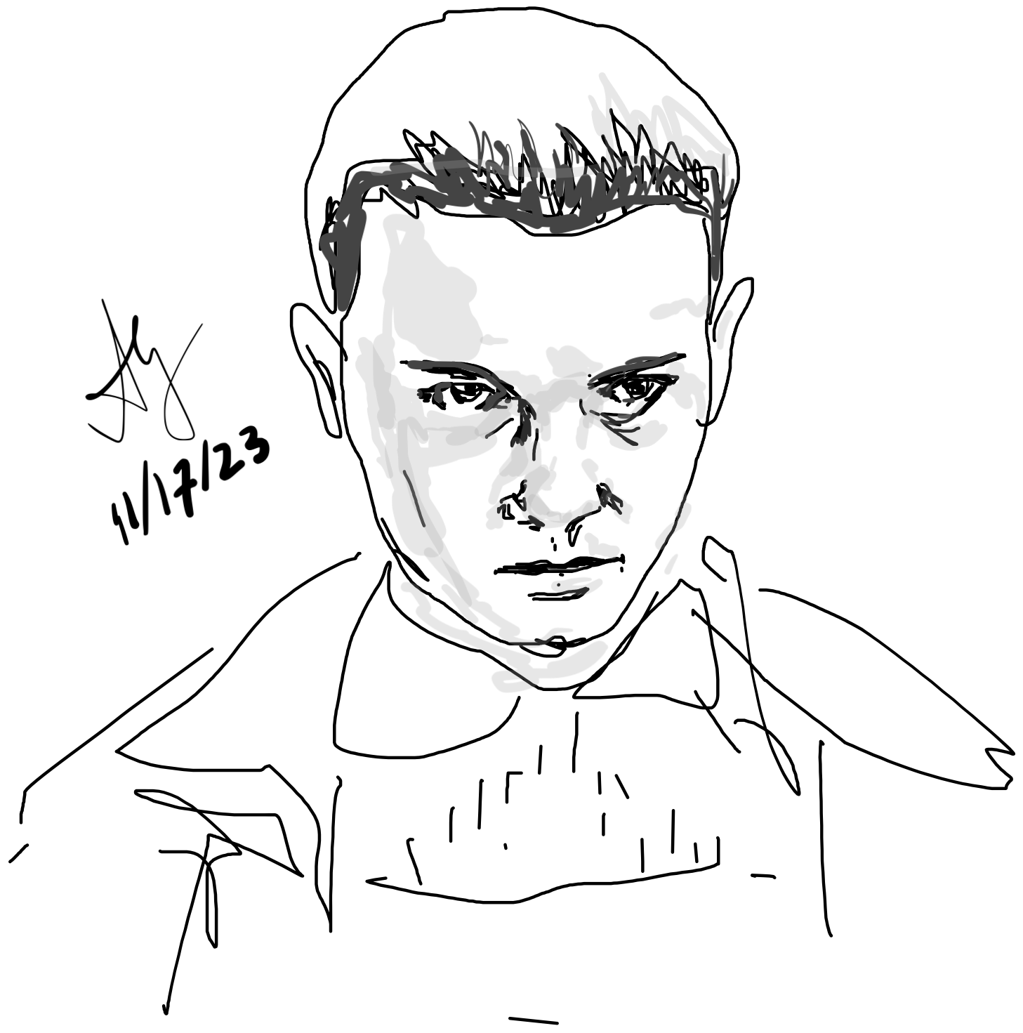
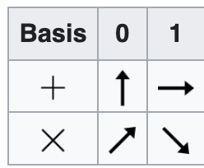
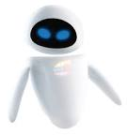
Alicia (“Alice”)
Millie Bobby (“Bob”)
”Eve”
Results are relevant along a measurement axis
Measure along random pair of non-orth. bases
Alice randomly chooses one basis each time
and sends her measurements to Bob
Bob reads these along random bases too

Slide 10
rand(1,50) > 0.5 (Alice)
1 0 0 0 0 1 0 1 0 0 0 1 0 0 0 1 0 1 0 1 0 1 0 0 0 1 1 1 0 1 1 1 1 1 0 1 0 0 1 0 0 1 1 0 1 0 1 1 0 1
%% Quantum Key Distribution
s = '+X';
%find number of random characters to choose from
numRands = length(s);
%specify length of random string to generate
sLength = 50;
%generate random string
randBasis = s( ceil(rand(1,sLength)*numRands) )
randBasis =
'+X+X+X+XXX+++X+XXX+++X+XXX+++X+X++++XXX+XX+X++++++’
(Bob)
randBasis=
'++XX+++X++X+++++XXX+++X+++XXX+X+X+X++XX+XX++++XXXX’
They match bases later (publicly) and discard mismatches

Slide 11
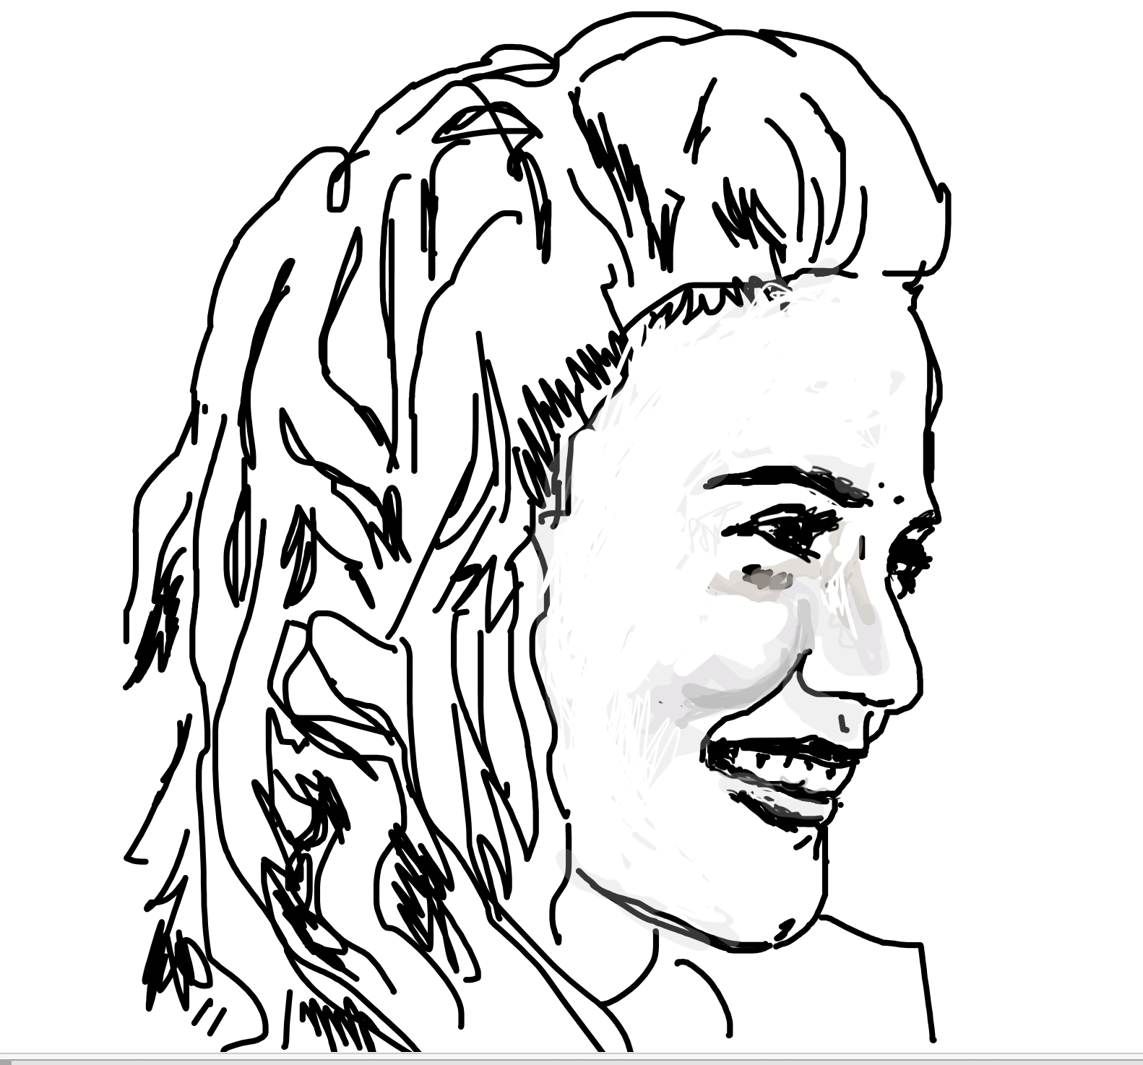
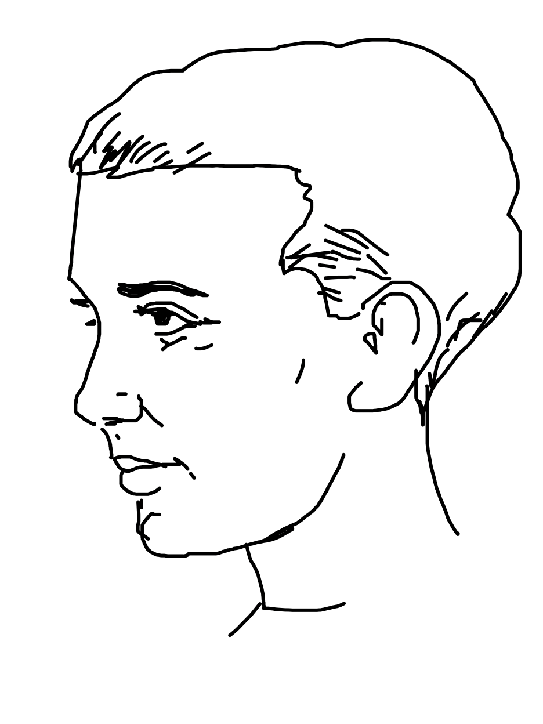
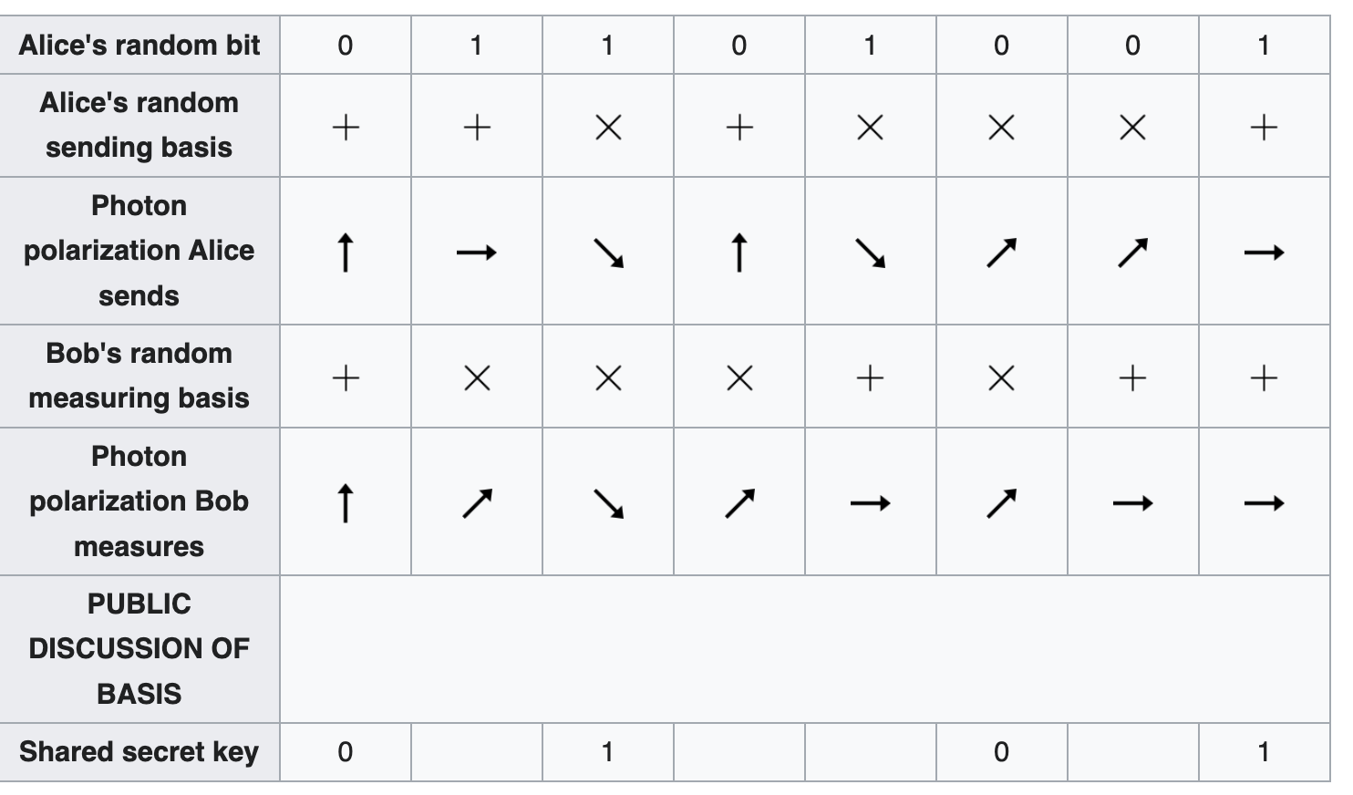
Discard non-matching bases
Eve knows the bases but not the measurements.
If she snoops, Bob’s results will be wrong. Bob can check a pre-determined subset to look for errors.

