Slide 1
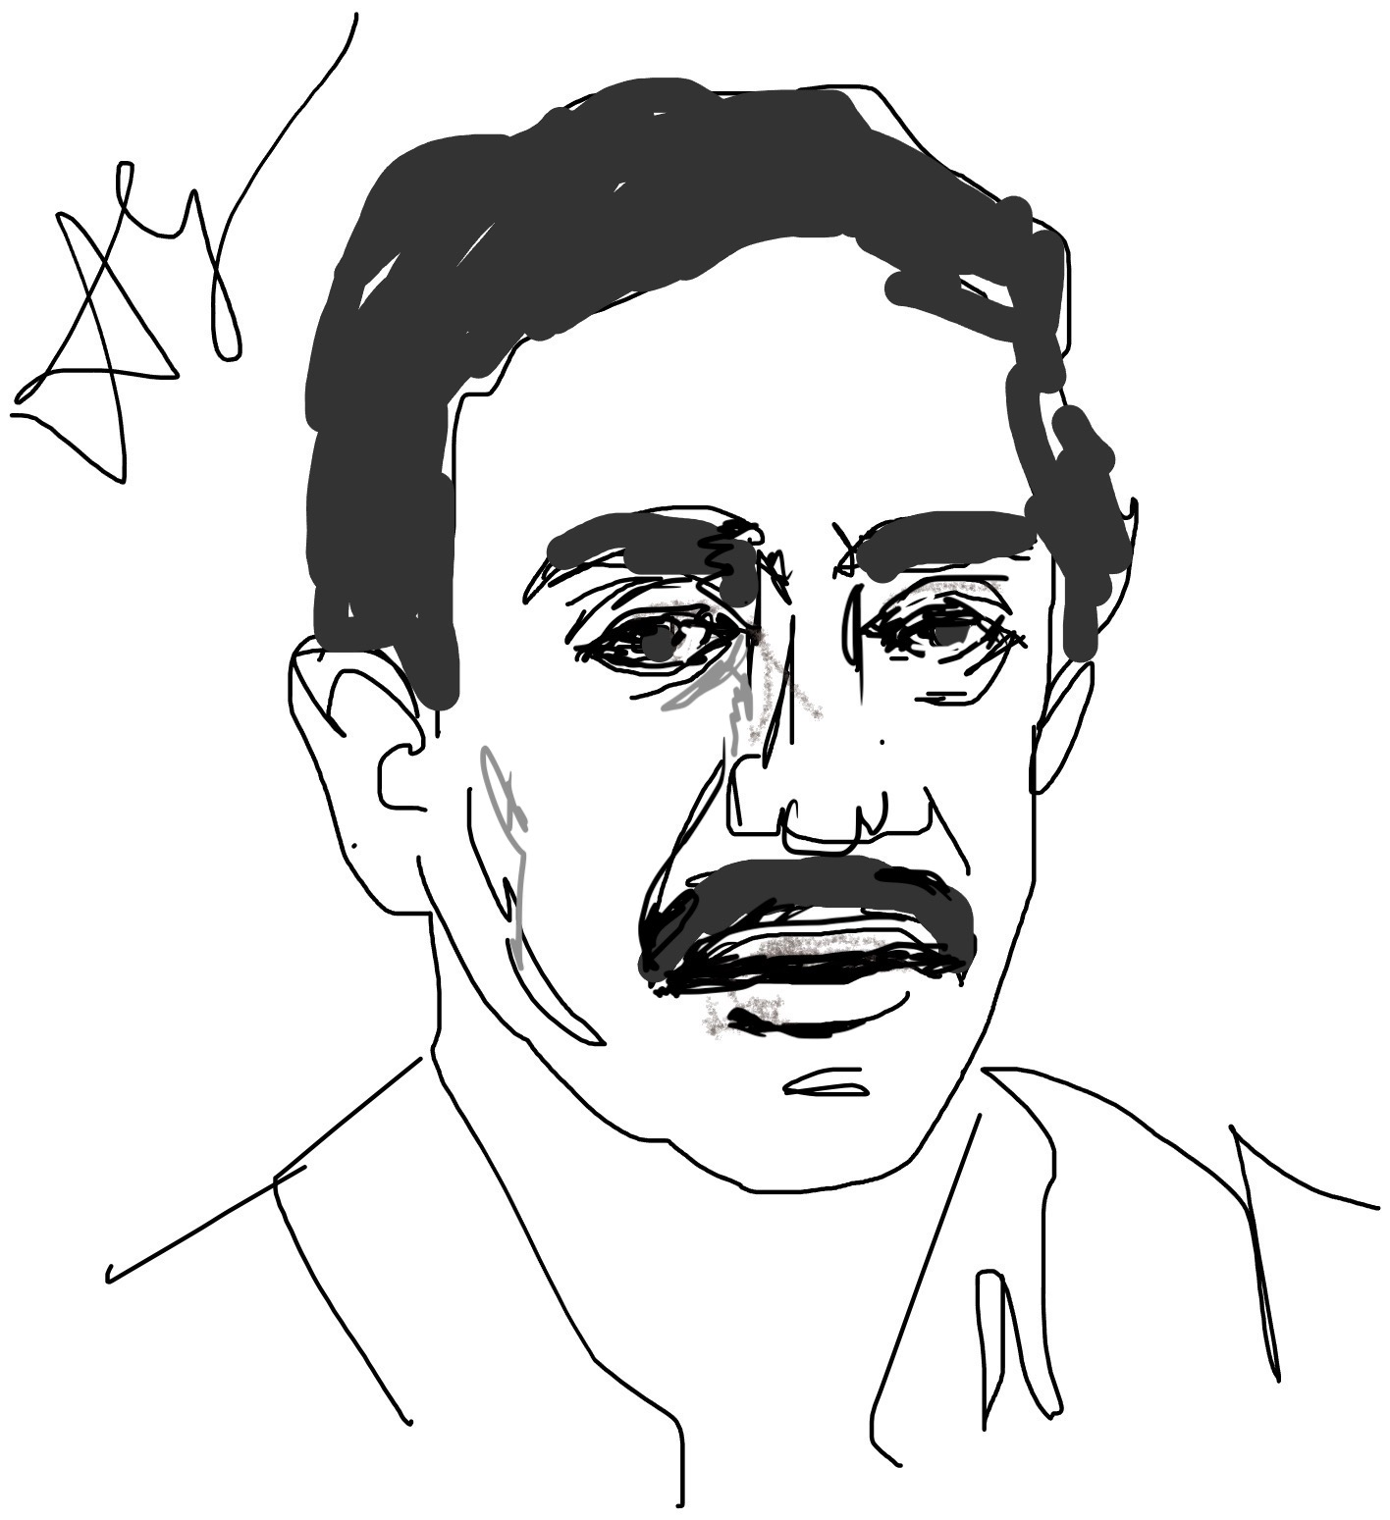
14B. Grover Search Algorithm
Lov Kumar Grover

Slide 2
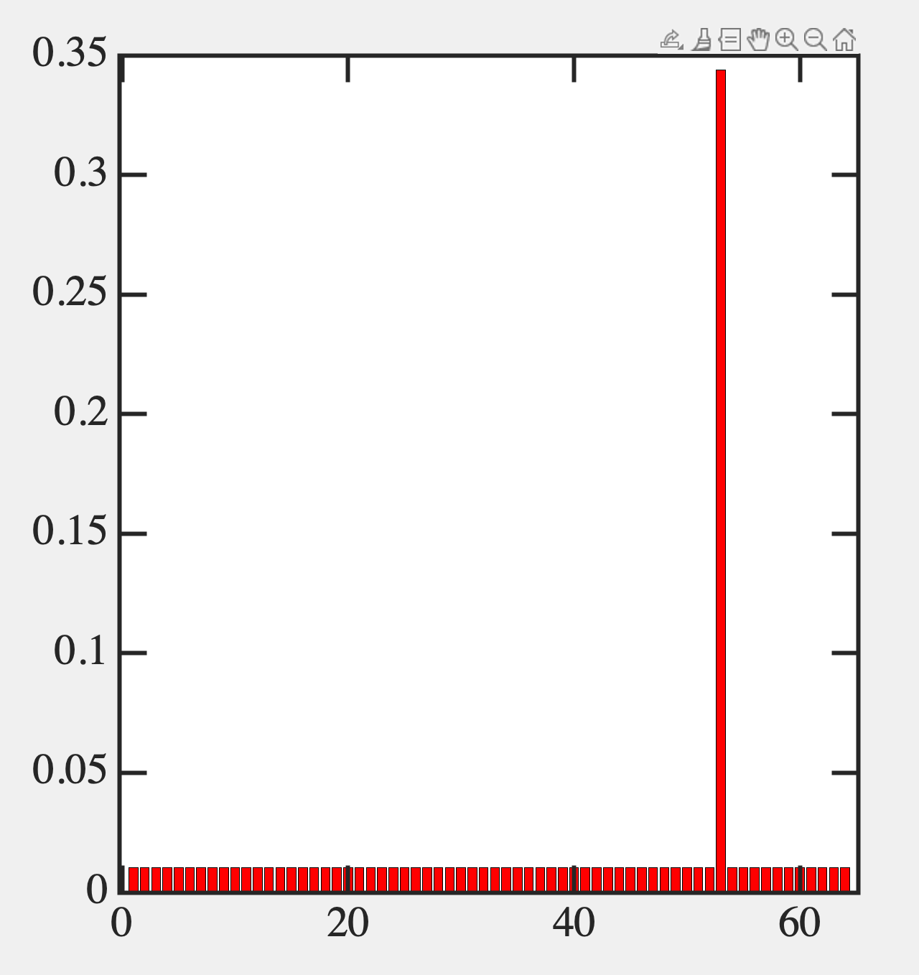
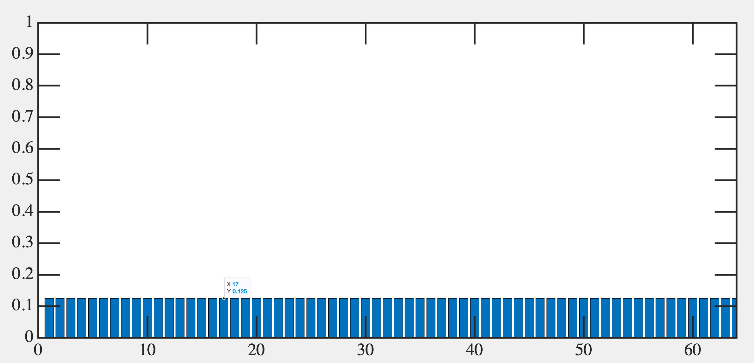
Search Algorithm

Slide 3
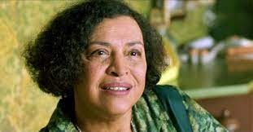
Oracle and Diffusion
Like a quantum Sobel Filter

Slide 5
Time Evolution

Slide 6
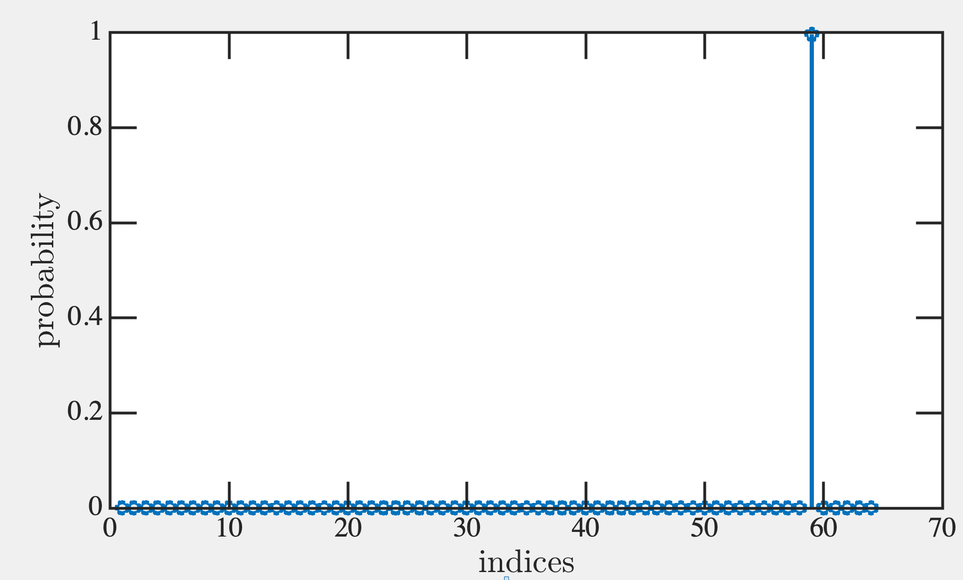
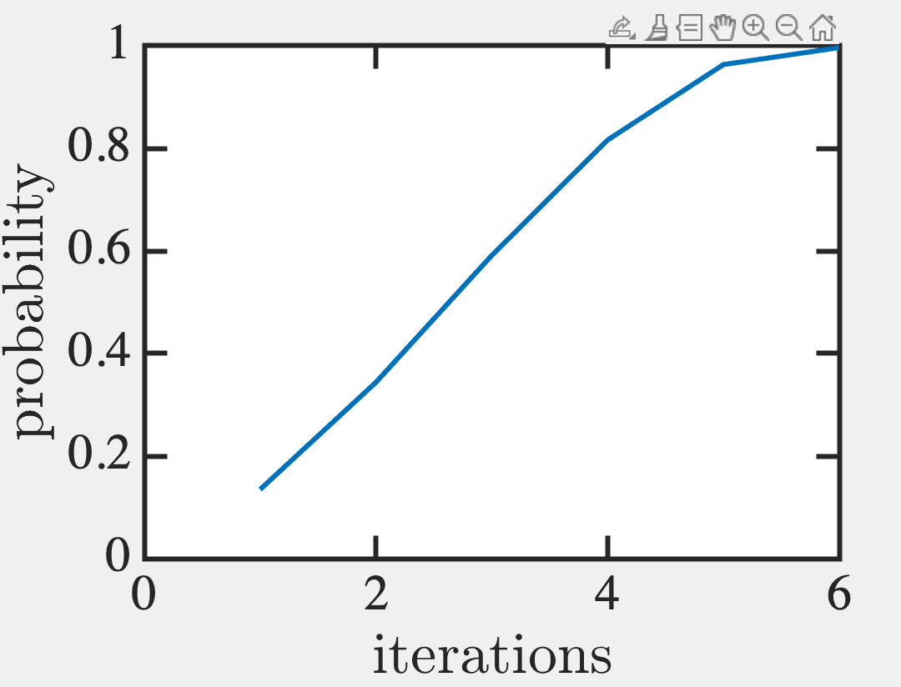
Eugene V. Makarov (2023). gsa.m (https://www.mathworks.com/matlabcentral/fileexchange/4711-gsa-m), MATLAB Central File Exchange. Retrieved November 20, 2023.
%This script simulates the Quantum Mechanical Lov Grover's Search Alghorithm.
clear all;
%-----parameters-----------
nqubits=6;%number of q-bits
n=2^nqubits;%nnumber of elements in database
findmode=mod(round(n*rand+1),n);%desired element
%-----defining quantum gates
d=-eye(n)+2/n;%diffusion transform
oracle=eye(n);%oracle
oracle(findmode,findmode)=-1;
%--calculate the optimal number of iterations---
finish=round(pi/4*sqrt(n));
%--step(i)--initialization----
psistart=ones(n,1)/sqrt(n);
psi=psistart*exp(i*rand);
%step (ii)--algorithm body----
for steps=1:finish
steps
psi=d*oracle*psi;
probability(steps)=psi(findmode)*conj(psi(findmode));
end
%see the probability dynamics
plot(probability);
%see the result distribution
figure;
stem(psi.*conj(psi));

Slide 7
Create a Hadamard Superposition of all bits
Do a Oracle Uω operator
Do a Grover diffusion operator U_{s}
4. Measure results
Rinse & Repeat

