Slide 1
14C. Shor factoring algorithm
Peter Shor

Slide 2
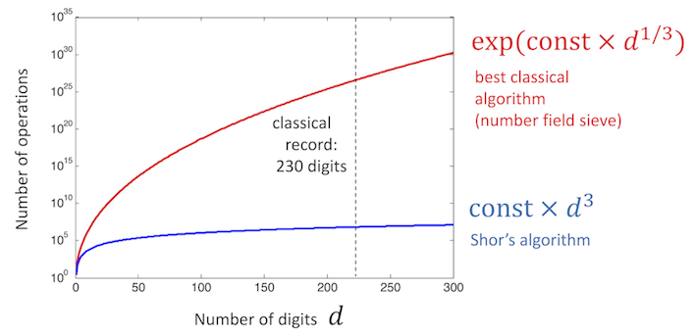
Useful for Quantum Cryptography
1e29 = 29996224275833 x 3475385758524527
(LOCK) (MESSAGE/CODE) (KEY)
Classical computer doing
20 GFLOPS needs
10¹⁵/20x10⁹ ~ 0.5 day
to solve this
Largest prime has
22,338,618 digits →
4000 years!

Slide 3
SHOR’S ALGORITHM
Given a number N, choose coprime a
Algo (from number theory)
F(x) = a^{x}mod(N) is periodic in x
Find period r of F(x) [QFT]
(it’s even)
2. Candidate Factors are
p, q = gcd(a^{r/2 ±} 1,N)

Slide 4
Example: N = 15, a = 7
Find period r of function
F(x) = 7^{x}mod(15)
F(0) = 1
F(1) = 7
F(2) = 4
F(3) = 13
F(4) = 1
.. → Period r = 4

Slide 5
2. Factors are
p = gcd(7^{4/2 +} 1,15) = gcd(50,15) = 5
q = gcd(7^{4/2 -} 1,15) = gcd(48,15) = 3
At least one of them guaranteed to work

Slide 6
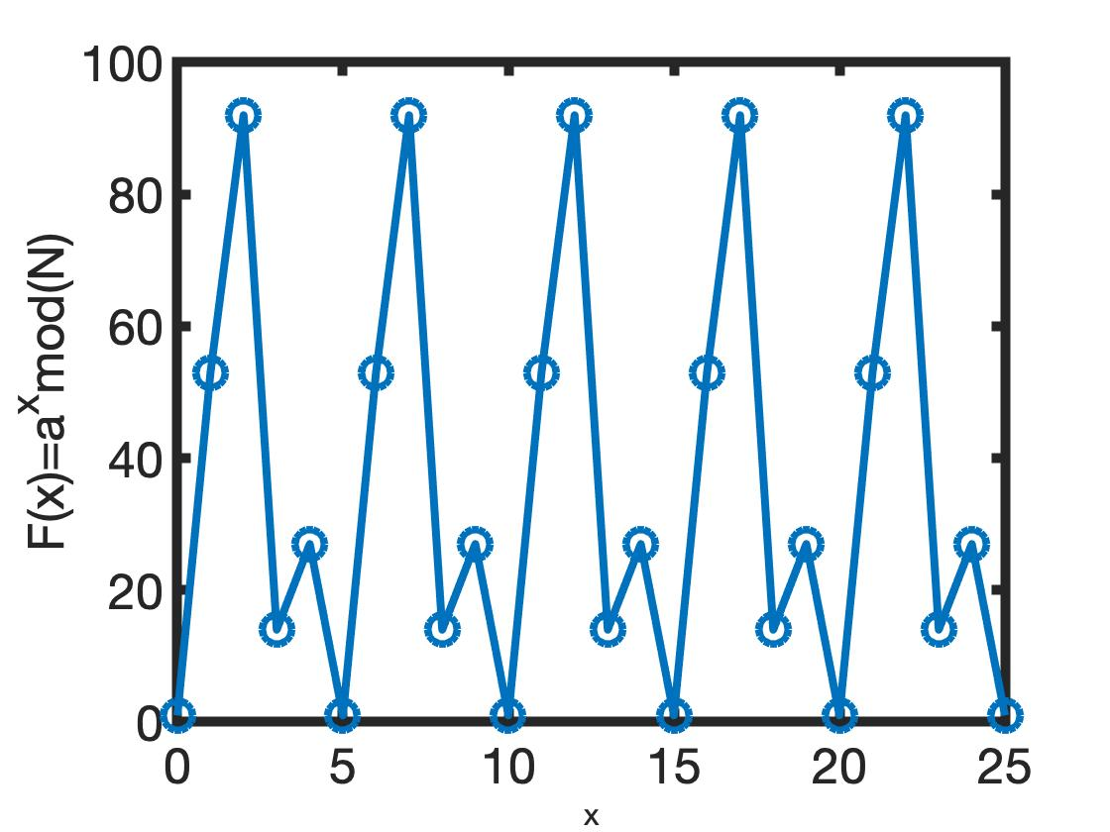
Larger Numbers
N = 143
a = 53
r = 5
Gcd(a^{r/2}+1,N) = 1
Gcd(a^{r/2}-1,N) = 13
143 = 13 x 11
To avoid round-off errors
use symbol operation
F=mod(sym(a).^x,N)
[ 1, 53, 92, 14, 27, 1, 53, 92, 14, 27, 1, 53, 92, ...]

Slide 7
IMPLEMENTATION (N=15, a=7)
Choose input and output registers
Choose q such that N² < q=2^{l} < 2N²
[e.g. q = 256 →
Input register: 8 qubits, 0 …. 255]
Output needs enough to capture N=15
[4 qubits]

Slide 8
To find periodicity r of F(x) = a^{x}modN
Superposition, Entangle input-output
|00000000, 0000> + |00000001, 0000> +
|00000010, 0000> + |00000011, 0000> +
……. + |11111111, 0000>
Operate with 7^{x}mod(15) → 255 answers
and place in output register
x₁=0
0
x₂=1
0
x₃=2
0
x₄=3
0
x₂₅₆=255
0

Slide 9
To find periodicity of a^{r}modN
Entangle input-output
|00000000, 0001> + |00000001, 0111> +
|00000010, 0100> + |00000011, 1101> +
|00000100, 0001> + …. repeating output
[Outputs - 1, 7, 4, 13 in binary]
x₁
7⁰mod15 = 1
x₂
7¹mod15 = 7
x₃
7²mod15 = 4
x₄
7³mod15 = 13
x₅
7⁴mod15 = 1

Slide 10
Measure output → Say we read “1”
Collapse input into a subset
[0, 4, 8, 12, 16, .., 252] Period r = 4.
We still haven’t opened blue box..
|00000000, 0001> + |00000100, 0001> +
|00001000, 0001> + |00010000, 0001> +
..…
+ | 11111100 , 0001>
How to read r in 1 shot?
0
1
4
1
8
1
12
1
252
1

Slide 11
Measure period with Q Fourier Transform
(Quantum Phase Shift Gates)
[0, 4, 8, 12, 16, .., 252]
But with different probabilities, peaking
around 252/r = 64. So highest probability
are 0, 64, 128, 192.
Let it collapse again repeatedly
→ GCD measures to p=64
Then from p=64 and q=256, we can get r=4
(continuous fraction expansion of q/p)
Finally, gcd(7^{r/2} ± 1)

Slide 12
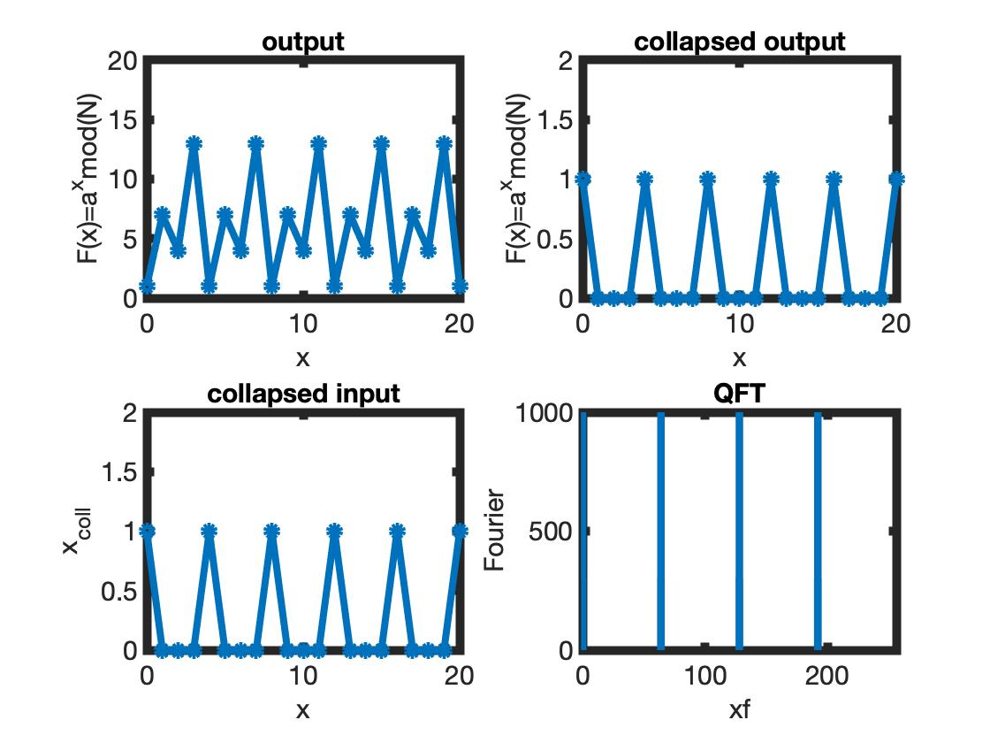
Read 1
Period 64
x = [0 4 8 12… 252]

Slide 13
Linear
superposition
0
x
x
f(x)
Period extraction
= M/r
Measure
period
QFT
QFT
U
f(x)
0
Entangle
Measure

