Slide 1
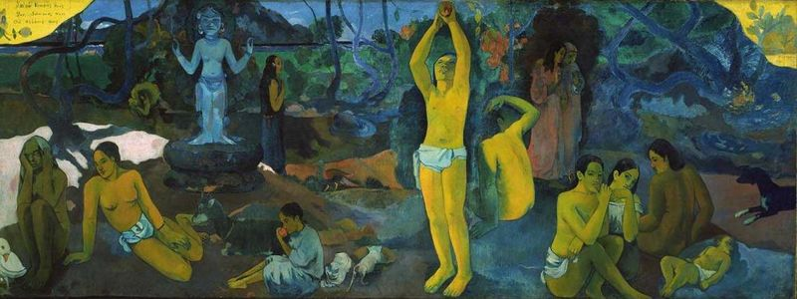
Keith Williams, University of Virginia, 21 April 2014
P. Gaugin
Where do we come from?
What are we?
Where are we going?

Slide 2
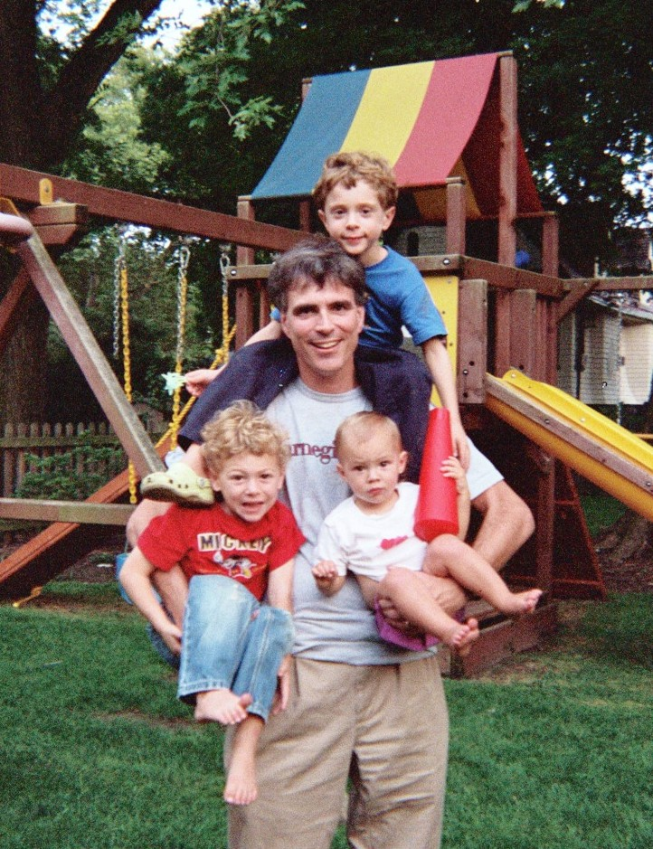
Last Lecture: Really Achieving Your Childhood Dreams
c
Randy Pausch
Carnegie Mellon University
Sept 18, 2007
Notes:
Randy Pausch was a computer scientist who faced a lot of adversity toward the end of his life… which helped him put a lot of things in perspective.

Slide 3
Brick walls are there for a reason:
they let us prove how badly we want things -Randy Pausch
Notes:
My favorite Randy Pauschism: how to approach the brick walls.

Slide 4
Brick walls are there for a reason:
they let us prove how badly we want things -Randy Pausch
It won’t work…
It’s too hard…
It’s too expensive…
Notes:
We all have brick walls. And sometimes the brick walls are inscribed with discouraging messages.

Slide 5
Brick walls are there for a reason:
they let us prove how badly we want things -Randy Pausch
It won’t work…
It’s too hard…
It’s too expensive…
You’re not experienced / mature /
credentialed / connected / old /
schooled/ serious / published / white / male / straight / wealthy /
etc. enough…
Notes:
We all have brick walls. And sometimes the brick walls are inscribed with discouraging messages.

Slide 6
Brick walls are there for a reason:
they let us prove how badly we want things -Randy Pausch
It won’t work…
It’s too hard…
It’s too expensive…
You’re not experienced / mature /
credentialed / connected / old /
schooled/ serious / published / white / male / straight / wealthy /
etc. enough…
If it were that easy somebody
would have done it before…
Notes:
We all have brick walls. And sometimes the brick walls are inscribed with discouraging messages.

Slide 7
Brick walls are there for a reason:
they let us prove how badly we want things -Randy Pausch
If you haven’t had…
MAE 2300, CE 2300 MSE 3050, APMA 3080, STS 2180, ARCH 2010
CHE 2202, APMA 3120, STS 2500, BME 2000, SYS 2202, BME 2104, ECE 3760, MAE 4620, BME 2102,
CHE 3347, CS 2110, MAE 4130,
MAE 4280, SYS 2620,
STS 2170, SYS 4053 or even
PHYS 1425, 1429, 2415 and 2419…
then YOU’RE NOT READY .
Notes:
At it’s best, school prepares us to face brick walls. At its worst, it feels like an endless series of brick walls.

Slide 8
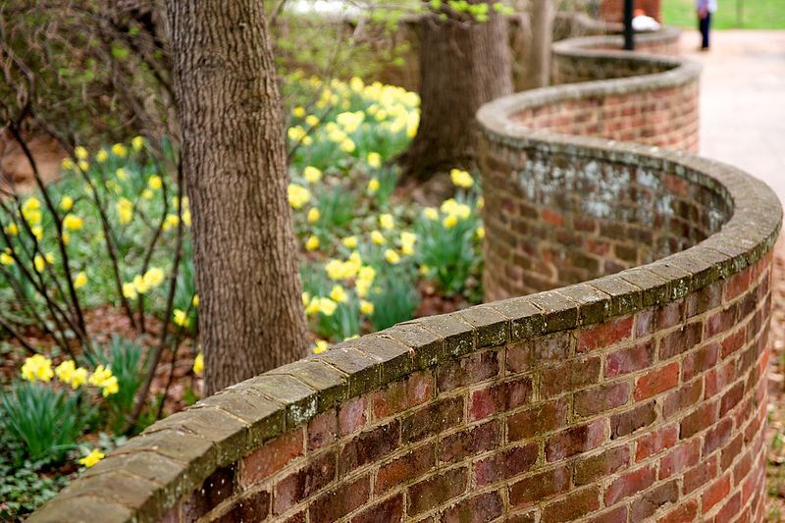
At a traditional place like UVa,
we sure love our brick walls…
Notes:
Some will understand this slide; some will not.

Slide 9
At a traditional place like UVa,
we sure love our brick walls…
Sometimes even more than
what’s on the other side.
Notes:
Some will understand this slide; some will not.

Slide 10
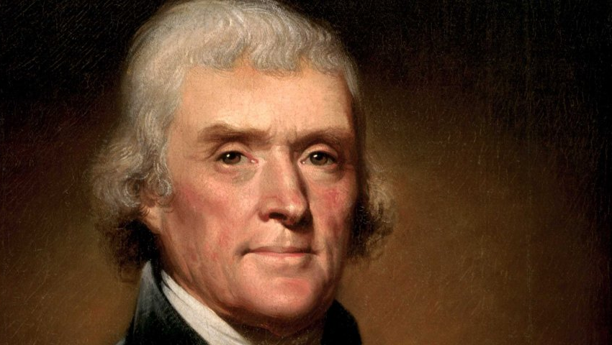
“do it”
-Thomas Jefferson
Notes:
What would TJ say?

Slide 11
“Of liberty I would say that, in the whole plenitude of its extent, it is unobstructed action according to our will. But rightful liberty is unobstructed action according to our will within limits drawn around us by the equal rights of others. I do not add “within the limits of the law,” because law is often but the tyrant’s will, and always so when it violates the right of an individual.”
-Thomas Jefferson
Notes:
Okay that’s not *quite* what he said…. It was something about liberty and law and tyranny and all that ☺

Slide 12
“I am a great believer in luck,
and I find the harder I work,
the more I have of it.”
-Thomas Jefferson
Notes:
Okay here’s a *real* quote from TJ

Slide 13
“I’ve always felt every day is a gift;
now I’m wondering where to send the
thank-you card.”
- Randy Pausch, Time Management
Notes:
Back to Randy Pausch, who learned a lot in his final year about facing adversity. Where will you send your thank you cards?

Slide 14
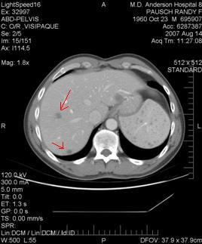
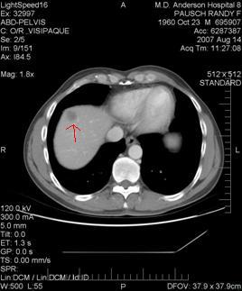
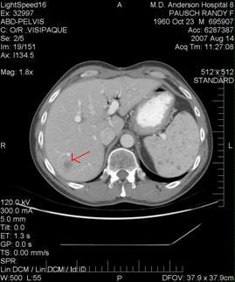
“I’ve always felt every day is a gift;
now I’m wondering where to send the
thank-you card.”
- Randy Pausch, Time Management
August 15th, 2007: “3 to 6 months”
Notes:
Back to Randy Pausch, who learned a lot in his final year about facing adversity. Where will you send your thank you cards?

Slide 15
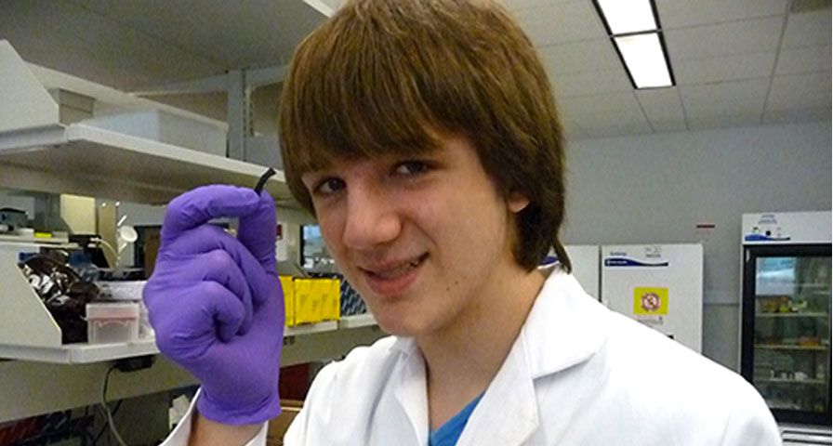
Even in times of hardship and quite often because of
times of hardship… we find inspiration.
Jack Andraka
Notes:
From adversity can come inspiration. And all you need is your Big Ideas, your work… and maybe a little help.

Slide 16
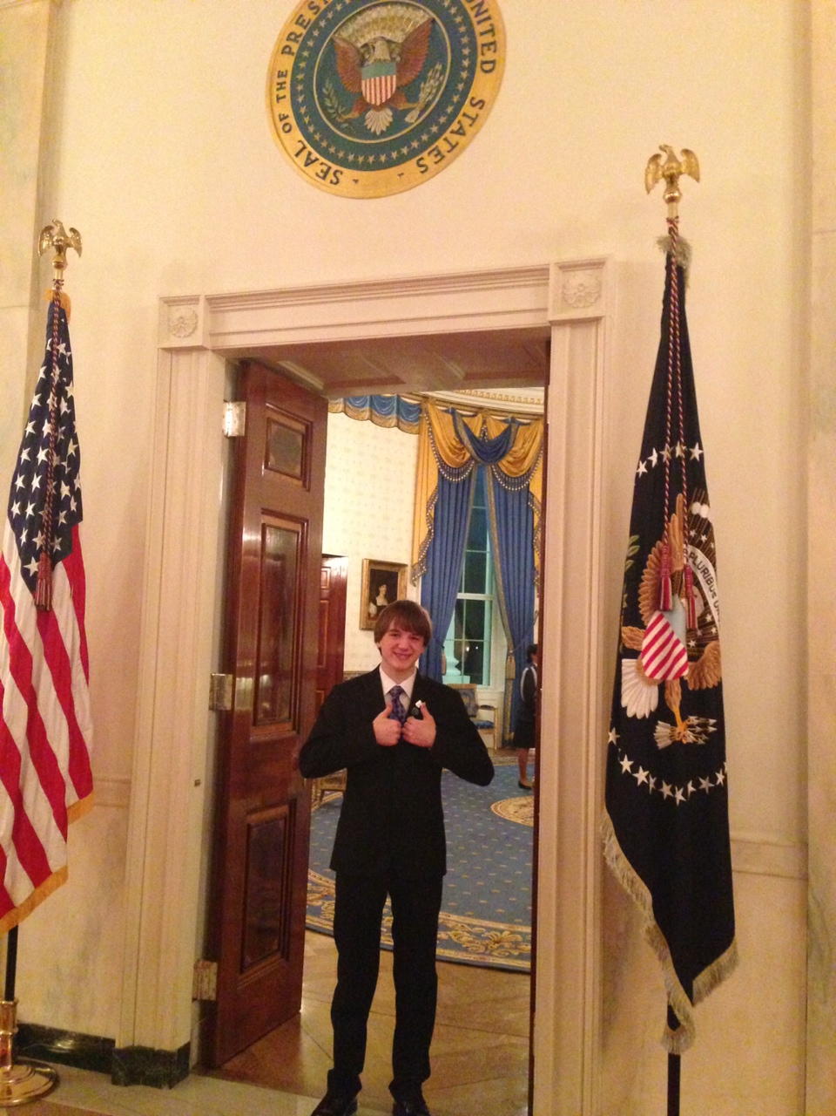
What
are
your
brick
walls
?
Notes:
Jack has a lesson for all of us about Big Ideas, facing adversity, and *making* success.

Slide 17
Thanks for visiting us, Jack!
Contacts:
Jack Andraka @jackandraka
Keith Williams @keithwms
Alex Zorychta @azorychta
Notes:
Thanks for visiting us, and here are some twitter links for those who want to stay in touch.

